Slide 1
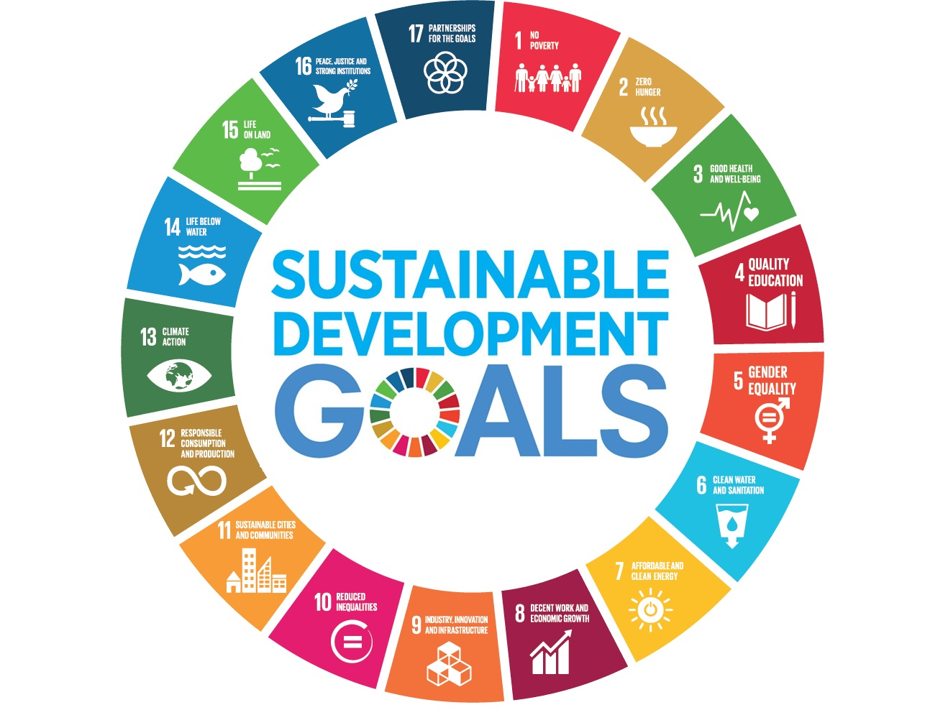

Understanding Agency: Business Students’ Perspectives on Sustainable Development Goal (SDG) Engagement and Challenges
Hayden Cronk
Doctoral Researcher- Sheffield Hallam University
Student Sustainability Research Conference 2025

Slide 2

Background and Rationale
With only 17% of the 169 SDG targets on track, a significant gap exists between the objectives set and our current progress (UN, 2024).
Business School (BS) students, as future business leaders, play a pivotal role in SDG implementation, as they will make decisions that directly impact SDG progress (Seva-Larossa et al., 2023).
While extensive research has explored university students’ SDG knowledge and awareness (Oltra-Badenes et al., 2023), little is known about their perceived agency in advancing the SDGs (Fischer & Newig, 2016).
Agency, through building an individuals’ confidence, engagement, and effectiveness in fostering meaningful change (Chawla & Cushing, 2007), is critical in shaping a more sustainable future (Koskela & Paloniemi, 2023).
Scholars have called for deeper exploration into how students view their agency to drive SDG implementation (Guerra et al., 2022).
Notes:
The Problem: Slow Progress- Critical roadmap for Global Sustainable Development.
Why Students? Their future influence in contemporary organisations underlines the necessity to examine their perceptions of their capacity to drive SDG advancement. Underpinning: Perceptions of an individual’s willingness and ability to embrace the SDGs significantly impact their implementation (Qasemi et al., 2023). University students play an essential role as catalysts for change (Boafo et al., 2024). Important to consider future professionals mindsets, next generation of sustainability leaders (Žalėniene & Pereira, 2021).
The Gap: Ultimately, what is the power of knowledge- little impact of BS students having the knowledge i.e., understanding importance- if they don’t feel like they can put this knowledge into action in their lives/career (Weybrecht, 2021). Increasing interest in examining how students perceive topics related to sustainable development (Concina & Frate, 2023). VA Gap- Students valuing SD, but not reflected in their behaviours.
Agency is connected to a sense of purpose, involving a belief in one’s own personal capacity and ability to create change (Dale, 2013). Understanding students’ perceived capacity to act is essential… Help to understand the underlying causes and mindsets that lead to a lack of progress (Bautista-Puig et al., 2024). Developing agency in students is critical for enabling them to become proactive contributors to sustainability transformations (Rap et al., 2022). Agency critical when societies face complex, interconnected challenges- like the SDGs (Dale, 2013).
This thesis addresses this gap through Aims and Questions on following slide.

Slide 3

Aim and Research Questions
The overarching aim of this study is to explore the perceptions, drivers, and barriers shaping final-year UK Business School (BS) students’ sense of agency in addressing the Sustainable Development Goals (SDGs).
This is guided by the following questions:
How do perceptions of agency to address the SDGs vary among final-year UK BS students?
What factors drive students’ sense of agency in contributing to the SDGs?
What factors inhibit students’ sense of agency in contributing to the SDGs?
What barriers do students perceive in engaging with SDG-aligned practices, and what strategies could help overcome these challenges?

Slide 4

Review of Literature (1)
Globally, young people are worried and pessimistic about the state of the environment and their ability to address Sustainable Development challenges (Philaka, 2020; Rap et al., 2022).
Although young adults show an interest in the global future, feelings of helplessness and powerlessness are common (Ojala, 2017).
While students acknowledge the importance of sustainable development, barriers including insufficient information, financial constraints, convenience, peer influences, and a tendency to displace responsibility (Chaplin & Wyton, 2014; Kagawa, 2007), diminish students' sense of personal agency in driving SDG advancement.
Young people feel marginalised, lack voice, and feel that their actions and decisions have no impact (Gunasiri et al., 2022; Nikolic et al., 2020).
Instead of facing the challenges- distancing strategies are often used i.e., “the problem does not concern me” “the challenges are exaggerated by media” (Ovais, 2023). A mindset tied to a limited awareness of the potential impact of individual actions on broader outcomes (Eagle et al., 2015).
Notes:
3. Suggest a pervasive VA gap.
4. Leading to mental health issues.
5. Displacement of responsibility a recurring theme- to governments, businesses.

Slide 5
Review of Literature (2)
Lee et al. (2023) | Salovaara et al. (2024) | Vandaele and Stålhammar (2022)
Examined Canadian students’ SDG engagement: Feelings of powerlessness and hopelessness hindered students’ capacity to act. Barriers driven by imposter syndrome, limited decision-making power and the overwhelming scale of the SDGs. Underscores the psychological and systemic challenges hindering students’ perceived capacity to effect meaningful change. | Examined how faculty and staff perceive their capacity to act as sustainable agents within their institutions: Feelings of hopelessness and powerlessness- often linked to others (government, peers) indifferent attitudes. Participants questioned their own commitment to sustainability because of this. Insufficient resources, time, and money identified as barriers. Scepticism surrounding the power of their own individual contribution, leading to feelings of anxiety and frustration over current progress. | Explores how emotions can impact university students' engagement with sustainability-based practices. University students, due to regular (fear-based) exposure via curriculum and media), often have negative emotions surrounding sustainable development issues. Finds that those with a more optimistic outlook, were more likely to engage in positive practices. Whereas pessimistic individuals were more likely to experience disengagement or denial.
Notes:
The anxiety and the lack of hope- leads to the feelings of powerlessness- often results in complete disengagement and inaction.

Slide 6

Methodology
Qualitative, interpretive-centred design, utilising semi-structured interviews.
Individuals often hold complex, layered, and nuanced perspectives on sustainability-related issues (Azmat et al., 2023; Lucio et al., 2019).
Perceptions of agency are inherently subjective experiences, shaped by personal beliefs, circumstances, emotions, and social interaction (Emirbayer & Mische, 1998).
This approach enables exploration of these subjective and socially constructed meanings (Creswell & Creswell, 2018), helping to uncover the layered perspectives that individuals attach to SDG-based topics (Concina & Frate, 2023).
Interview undergraduate BS students from post-92 universities until data saturation is reached.
Notes:
2. Academia is constantly advancing and evolving (Oltra-Badenes et al., 2023). Value-laden attitudes.
3. Agency is dynamic, evolving, and context-dependent (Hitlin & Elder, 2007)- interpretive useful when exploring a complex concept like agency/sustainability- with complex narratives.
4. Rich, nuanced data. Contributing new insights within the unexplored UK BS context.
5. SDG-related research typically focused on elite ‘redbrick’ universities (Filho et al., 2018), less focus on post-92’s- which emphasise applied, community-driven learning- aligning closely with practical SDG engagement (Hunt, 2016). Undergraduates- proximity to entering workforce. BSs most competitive and fastest-growing HE sector globally (Lozano et al., 2020).

Slide 7

Impact and Contribution
Inadequate attention to human behaviour and agency noted in the sustainability transition literature (Huttunen et al., 2021).
Limited focus has been given to how students perceive their agency and the factors shaping their capacity to contribute to the SDGs (Hassan et al., 2016), highlighting the need for a more ‘student-centric’ perspective (Jones et al., 2024).
By adopting a qualitative approach, this thesis addresses these gaps, offering a rich, contextualised exploration of how BS students perceive their agency in advancing the SDGs.
Through exploring these nuanced perceptions, drivers, and barriers, this study can guide BSs, policymakers, and businesses in developing initiatives that enhance students’ agency in SDG-related engagement.
Notes:
The project’s significance is considerable.
1. Generally
2. Little attention particularly on BS students (Bask, 2020). Go back to the importance of students as future decision-makers and influencers- here, we are giving students a voice, often feel marginalised- like they cant act or have no power.
3. Crucial to understand perceptions, SDG-based knowledge acquired during university has limited impact if students lack the agency to effect change in personal and professional contexts.
4. Critical considering that only 17% of targets are currently on track.

Slide 8
Thank you very much for listening!
I am happy to take any questions.
Contact: h.cronk@shu.ac.uk
Find me on LinkedIn: Hayden Cronk

Slide 9
References (1)
Azmat, F., Jain, A., & Sridharan, B. (2023). Responsible management education in business schools: Are we there yet? Journal of Business Research, 157, 113518 https://doi.org/10.1016/j.jbusres.2022.113518
Chaplin, G., & Wyton, P. (2014). Student engagement with sustainability: understanding the value-action gap. International Journal of Sustainability in Higher Education, 15(4), 404–417. https://doi.org/10.1108/IJSHE-04-2012-0029
Chawla, L., & Cushing, D. F. (2007). Education for strategic environmental behavior. Environmental Education Research, 13(4), 437–452. https://doi.org/10.1080/13504620701581539
Concina, E., & Frate, S. (2023). Assessing University Students’ Beliefs and Attitudes towards Sustainability and Sustainable Development: A Systematic Review. Trends in Higher Education, 2(4), 705–717. https://doi.org/10.3390/higheredu2040041
Creswell, J. W., & Creswell, J. D. (2018). Research design : qualitative, quantitative & mixed methods approaches (5th ed.). SAGE.
Eagle, L., Low, D., Case, P., & Vandommele, L. (2015). Attitudes of undergraduate business students toward sustainability issues. International Journal of Sustainability in Higher Education, 16(5), 650–668. https://doi.org/10.1108/IJSHE-04-2014-0054
Emirbayer, M., & Mische, A. (1998). What is agency ? The American Journal of Sociology, 103(4), 962–1023. https://doi.org/10.1086/231294
Fischer, L.-B., & Newig, J. (2016). Importance of Actors and Agency in Sustainability Transitions: A Systematic Exploration of the Literature. Sustainability, 8(5), 476-. https://doi.org/10.3390/su8050476
Guerra, A., Jiang, D., & Du, X. (2022). Student Agency for Sustainability in a Systemic PBL Environment. Sustainability, 14(21), 13728-. https://doi.org/10.3390/su142113728

Slide 10
References (2)
Gunasiri, H., Wang, Y., Watkins, E.-M., Capetola, T., Henderson-Wilson, C., & Patrick, R. (2022). Hope, Coping and Eco-Anxiety: Young People’s Mental Health in a Climate-Impacted Australia. International Journal of Environmental Research and Public Health, 19(9), 5528-. https://doi.org/10.3390/ijerph19095528
Hassan, L. M., Shiu, E., & Shaw, D. (2016). Who Says There is an Intention–Behaviour Gap? Assessing the Empirical Evidence of an Intention–Behaviour Gap in Ethical Consumption. Journal of Business Ethics, 136(2), 219–236. https://doi.org/10.1007/s10551-014-2440-0
Huttunen, S., Kaljonen, M., Lonkila, A., Rantala, S., Rekola, A., & Paloniemi, R. (2021). Pluralising agency to understand behaviour change in sustainability transitions. Sustainability Science, 16(5), 1541–1554. https://doi.org/10.1007/s11625-021-00999
Jones, T. E., Mack, L., & Gómez, O. A. (2024). Students’ perspectives of sustainable development goals in a Japanese higher education institute. International Journal of Sustainability in Higher Education, 25(1), 182–201. https://doi.org/10.1108/IJSHE-12-2022-0380
Kagawa, F. (2007). Dissonance in students’ perceptions of sustainable development and sustainability. International Journal of Sustainability in Higher Education, 8(3), 317–338. https://doi.org/10.1108/14676370710817174
Koskela, I.-M., & Paloniemi, R. (2023). Learning and agency for sustainability transformations: building on Bandura’s theory of human agency. Environmental Education Research, 29(1), 164–178. https://doi.org/10.1080/13504622.2022.2102153
Lee, B., Liu, K., Warnock, T. S., Kim, M. O., & Skett, S. (2023). Students leading students: a qualitative study exploring a student-led model for engagement with the sustainable development goals. International Journal of Sustainability in Higher Education, 24(3), 535–552. https://doi.org/10.1108/IJSHE-02-2022-0037
Lucio, L. P., Machado, M. K., de Moraes Hoefel, J. L., & Leal Filho, W. (2019). Sustainability Perceptions. In Encyclopedia of Sustainability in Higher Education (pp. 1725–1735). Springer International Publishing. https://doi.org/10.1007/978-3-030-11352-0_191
Nikolic, V., Vukic, T., Maletaski, T., & Andevski, M. (2020). Students’ attitudes towards sustainable development in Serbia. International Journal of Sustainability in Higher Education, 21(4), 733–755. https://doi.org/10.1108/IJSHE-11-2019-0336

Slide 11
References (3)
Ojala, M. (2017). Hope and anticipation in education for a sustainable future. Futures : The Journal of Policy, Planning and Futures Studies, 94, 76–84. https://doi.org/10.1016/j.futures.2016.10.004
Oltra-Badenes, R., Guerola-Navarro, V., Gil-Gómez, J.-A., & Botella-Carrubi, D. (2023). Design and Implementation of Teaching–Learning Activities Focused on Improving the Knowledge, the Awareness and the Perception of the Relationship between the SDGs and the Future Profession of University Students. Sustainability, 15(6), 5324-. https://doi.org/10.3390/su15065324
Ovais, D. (2023). Students’ sustainability consciousness with the three dimensions of sustainability: Does the locus of control play a role? Regional Sustainability, 4(1), 13–27. https://doi.org/10.1016/j.regsus.2023.02.002
Pihkala, P. (2020). Anxiety and the Ecological Crisis: An Analysis of Eco-Anxiety and Climate Anxiety. Sustainability, 12(19), 7836-. https://doi.org/10.3390/su12197836
Rap, D. B., Schrauwen, J. G. M., Marimuthu, A. N., Redlich, B., & Brünken, S. (2022). Low-temperature nitrogen-bearing polycyclic aromatic hydrocarbon formation routes validated by infrared spectroscopy. Nature Astronomy, 6(9), 1059–1067. https://doi.org/10.1038/s41550-022-01713-z
Salovaara, J. J., Kettunen, P., Veintie, T., Heikkinen, M., Ratvio, R., Södervik, I., & Pietikäinen, J. (2024). The potential and actuality of sustainability agency of university faculty and staff. Sustainability : Science, Practice, & Policy , 21(1). https://doi.org/10.1080/15487733.2024.2438423
Seva-Larrosa, P., Marco-Lajara, B., Úbeda-García, M., Zaragoza-Sáez, P., Rienda-García, L., García-Lillo, F., ... & Martínez-Falcó, J. (2023). Students´ perception of sustainable development goals (SDGs) and the benefits for companies derived from their implementation. Economic research-Ekonomska istraživanja, 36(1).
UN. (2024). The sustainable development goals report 2024. Retrieved from: https://unstats.un.org/sdgs/report/2024/The-Sustainable-Development-Goals-Report-2024.pdf
Vandaele, M., & Stålhammar, S. (2022). “Hope dies, action begins?” The role of hope for proactive sustainability engagement among university students. International Journal of Sustainability in Higher Education, 23(8), 272–289. https://doi.org/10.1108/IJSHE-11-2021-0463

