Slide 1

Psychotel 2: film installation and the neurodivergent uncanny
Dr Susannah Gent
Sheffield Hallam University

Slide 2
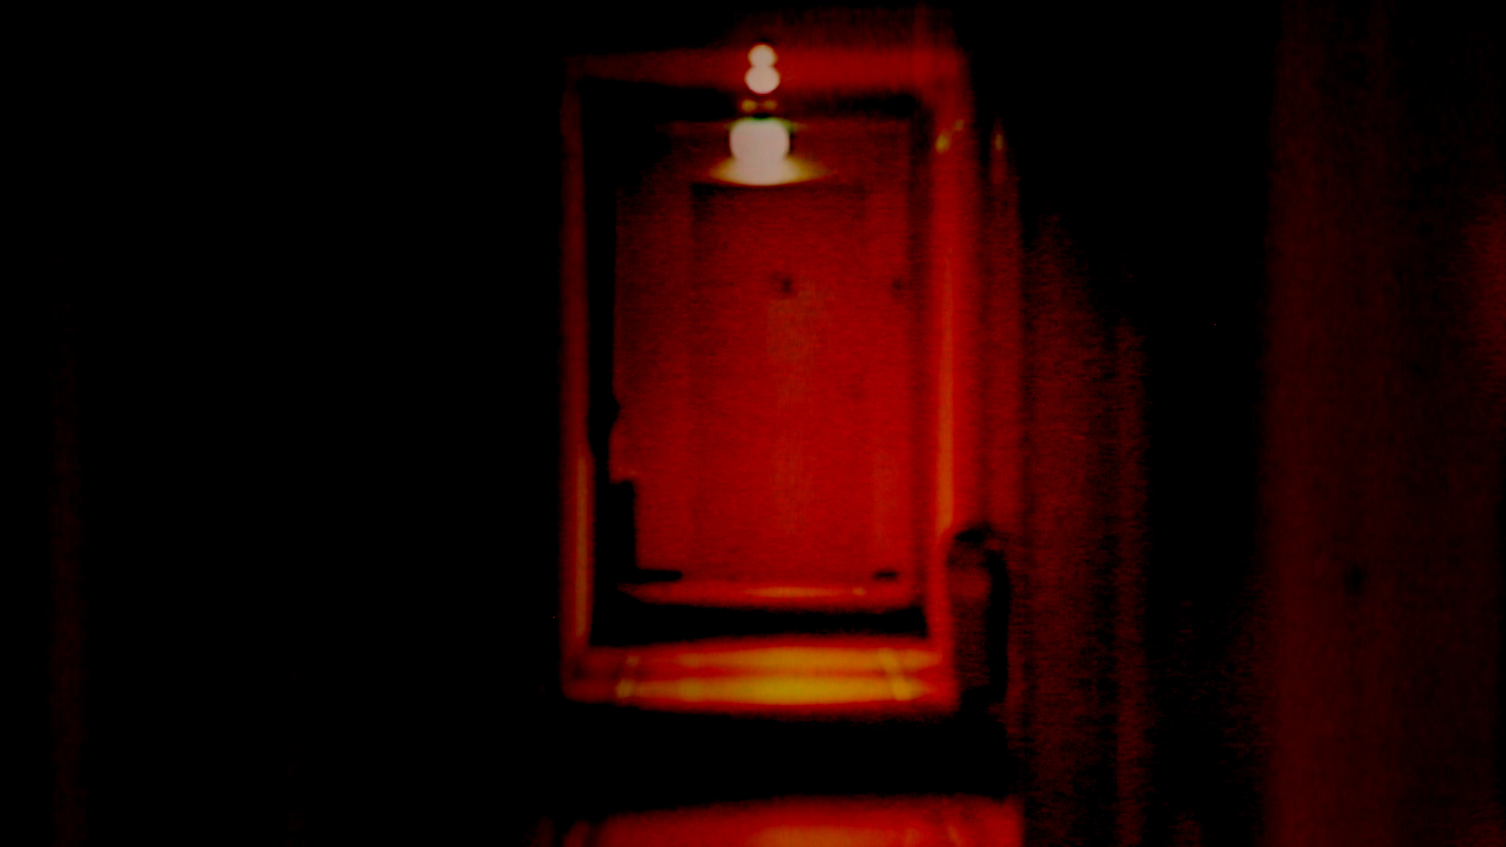
Psychotel 2: film installation and the neurodivergent uncanny

Slide 3
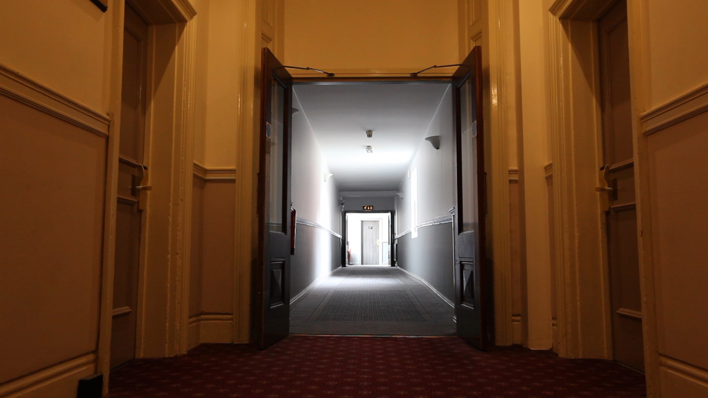
the neurodivergent uncanny?

Slide 4
‘The uncanny involves feelings of uncertainty, in particular the reality of who one is and what is being experienced’.
ROYLE, Nicholas, The Uncanny, Manchester: Manchester University Press, 2003, p. 1.

Slide 5
‘Suddenly one sense of oneself seems strangely questionable’.
ROYLE, Nicholas, The Uncanny, Manchester: Manchester University Press, 2003, p. 1.

Slide 6
‘It may be that the uncanny is a feeling that happens only to oneself, within oneself, but is never one’s ‘own’: its meaning or significance may have to do, most of all, with what is not oneself, with others, with the world ‘itself’.
ROYLE, Nicholas, The Uncanny, Manchester: Manchester University Press, 2003, p. 2.

Slide 7
‘People can be intensely focused on their body parts or sensations or workings, specifically because they perceive them as foreign, incomprehensible, ever new and ‘other’ and generally not aware that these things are part of themselves’.
WILLIAMS, Donna, Autism: An Inside-Out Approach, London: Jessica Kingsley Publishing, 1998, p. 14.

Slide 8
‘It may thus be construed as a foreign body within oneself, even the experience of oneself as a foreign body, the very estrangement of inner silence and solitude.’
ROYLE, Nicholas, The Uncanny, Manchester: Manchester University Press, 2003, p. 2.

Slide 9
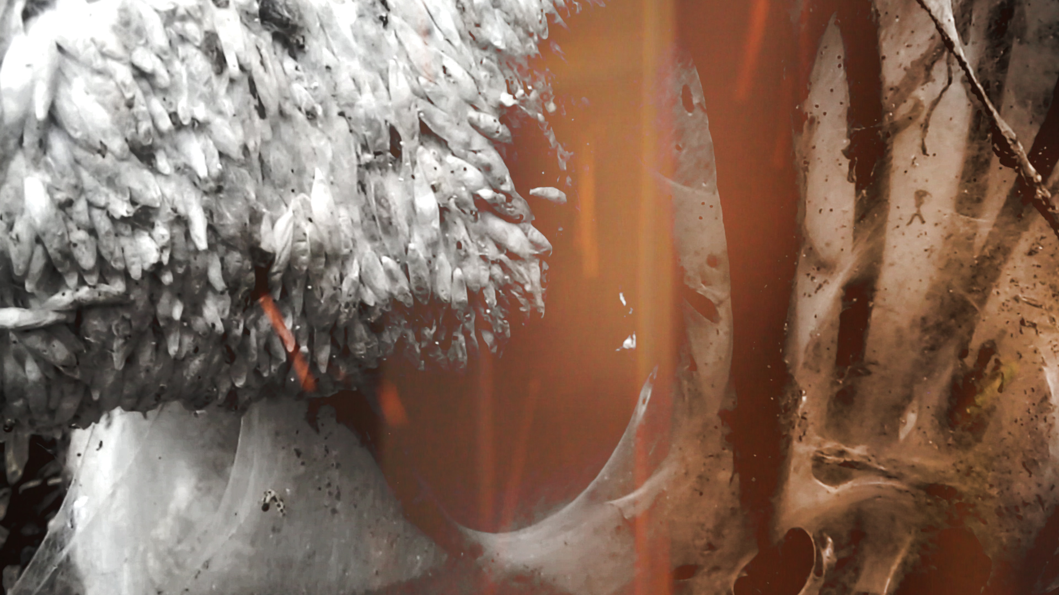
the Deleuzian uncanny?

Slide 10
‘The model of the body according to Spinoza, does not imply any devaluation of thought in relation to extension, but, much more important, a devaluation of consciousness in relation to thought: a discovery of the unconscious, of an unconscious of thought just as profound as the unknown of the body’.
DELEUZE, Giles, Nietzsche and Philosophy, translated by Hugh Tomlinson, London: Bloomsbury, 2006, p. 18—19.

Slide 11
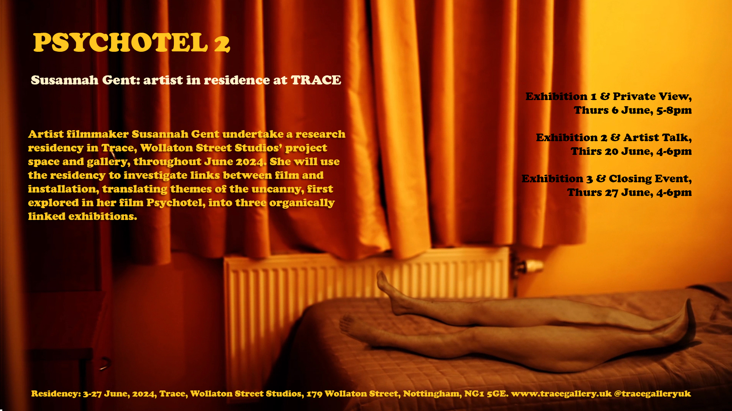
Psychotel 2

Slide 12
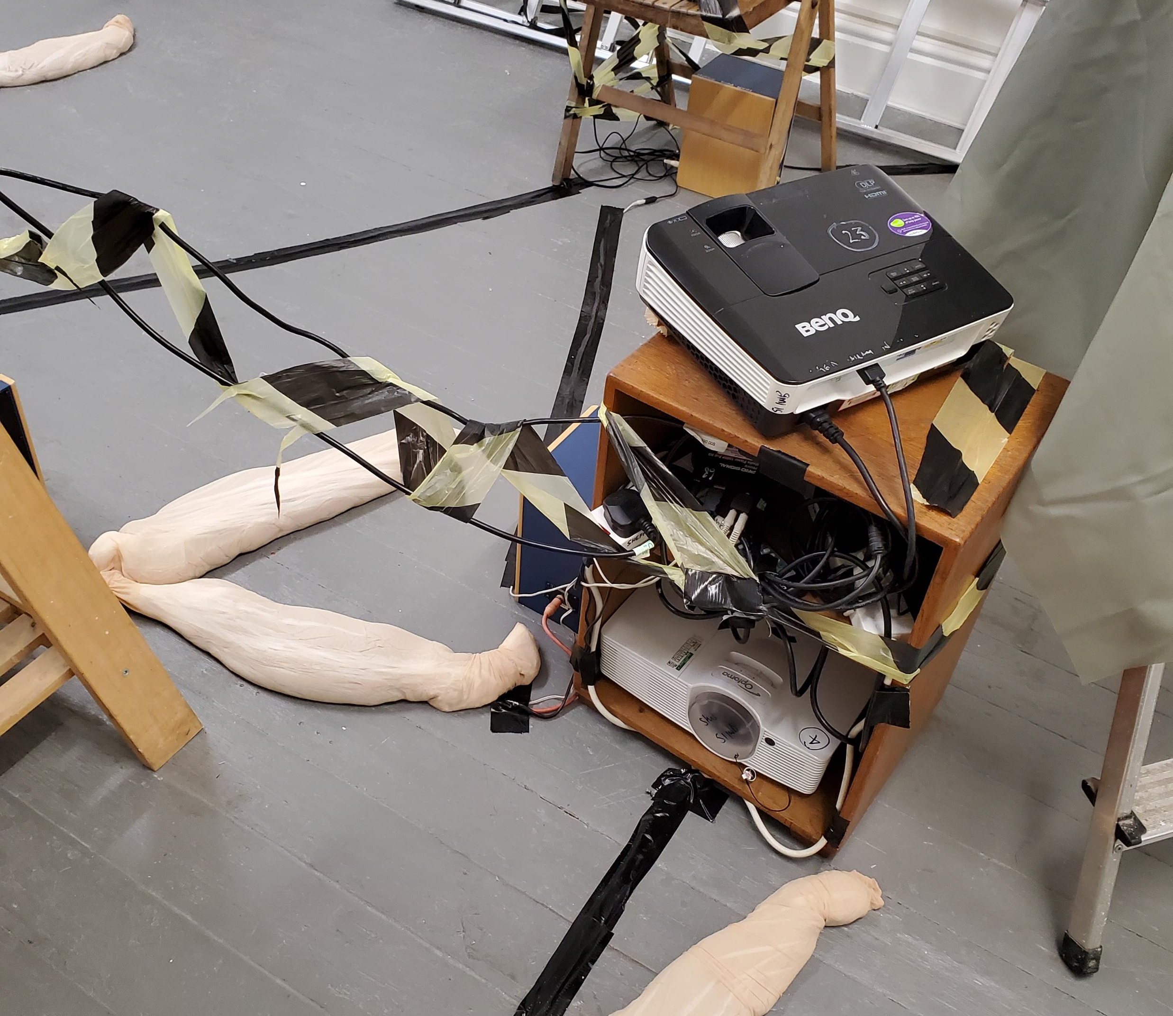
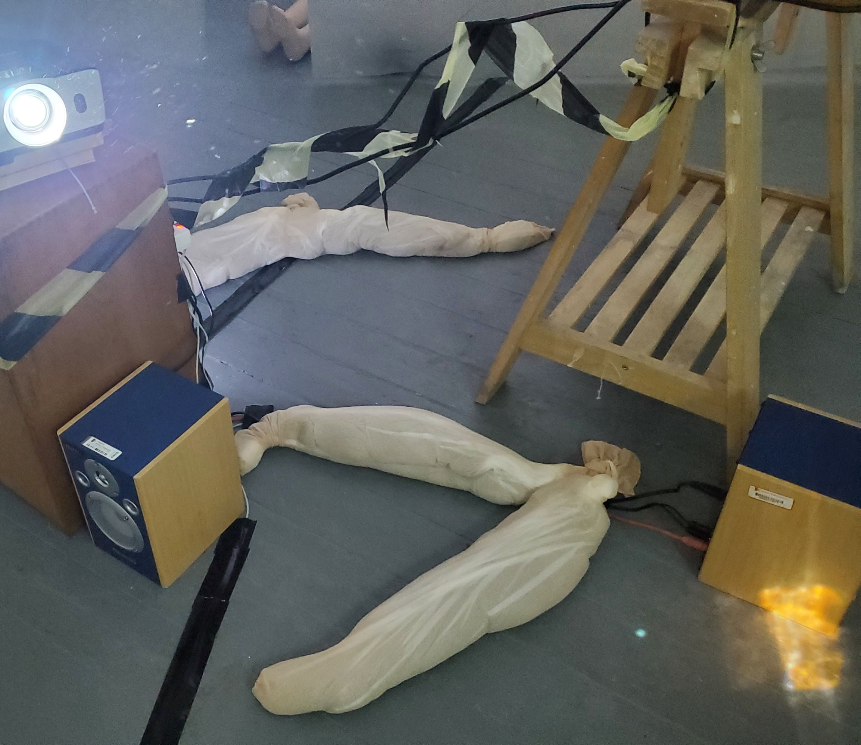
Psychotel 2: Installation 1, set-up

Slide 13
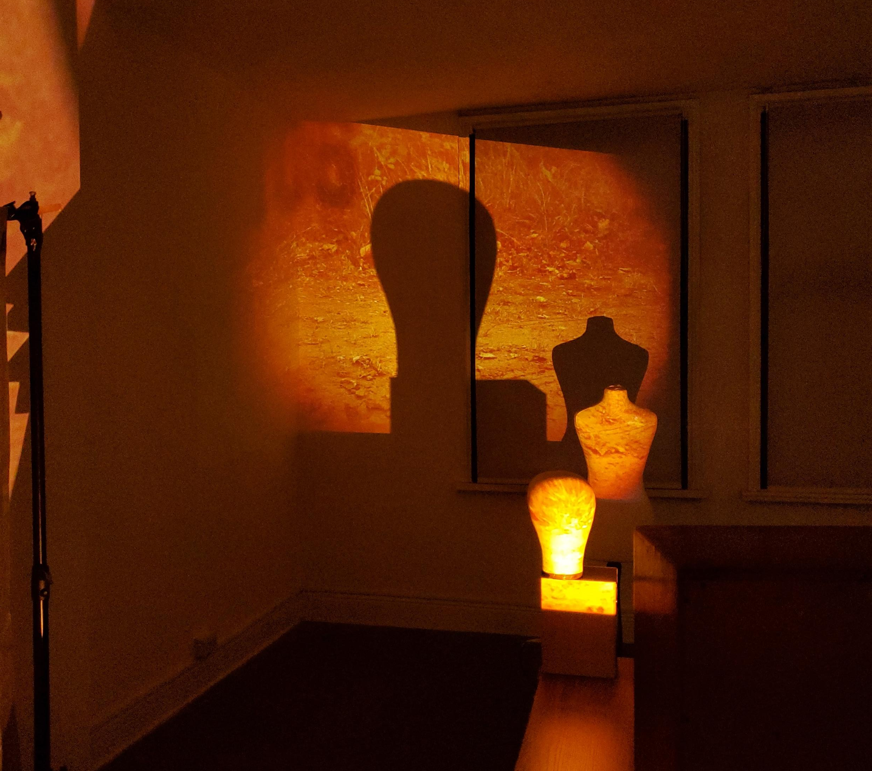
Psychotel 2: film installation and the neurodivergent uncanny

Slide 14
‘It is a very neurotypical perspective that teaches us that a body begins and ends in a skin envelope we can readily perceive.’
MANNING, Erin, The Minor Gesture, London: Duke University Press, 2016, p. 114.

Slide 15
‘The uncanny has to do with a strangeness of framing and borders, an experience of liminality.’
ROYLE, Nicholas, The Uncanny, Manchester: Manchester University Press, 2003, p. 2.

Slide 16
‘Autistic perception […] is not meant to describe a group of autistics. It is rather, a tendency in perception shared by all that privileges complexity of experience over category.’
MANNING, Erin, The Minor Gesture, London: Duke University Press, 2016, p. 112.

Slide 17
Links
https://susannahgent.weebly.com/psychotel.html
susannahgent.weebly.com

Slide 18

GENT, Susannah, ‘The Double and its Mirror: Reflections on the Production of Psychotel’, in Uncanny Horizons: Explorations of the “Unheimlich” in Literature, Film and Aesthetics, edited by Charlie Jorge, London Centre for Interdisciplinary Research, 2025

Slide 19
References
DELEUZE, Gilles and Felix Guattari, Anti-Oedipus: Capitalism and Schizophrenia, translatedlby Robert Hurley, Mark Seem and Helen R. Lane, Minneapolis, MN: University of Minnesota Press, 1983
DELEUZE, Giles, Nietzsche and Philosophy, translated by Hugh Tomlinson, London: Bloomsbury, 2006
MANNING, Erin, The Minor Gesture, London: Duke University Press, 2016
ROYLE, Nicholas, The Uncanny, Manchester: Manchester University Press, 2003
WILLIAMS, Donna, Autism: An Inside-Out Approach, London: Jessica Kingsley Publishing, 1998

