Slide 1
From niche activities to leverage points
What can a pilot regeneration scheme tell us about the potential for net zero transitions on the high street?
Julian Dobson, Sheffield Hallam University

Slide 2
Why the high street?
A crucible for local transitions and an intersection of complex systems

Slide 3
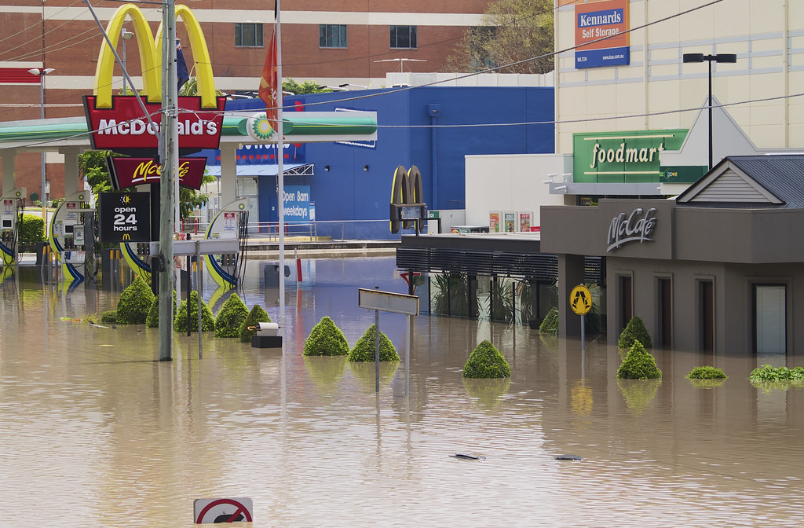
Vulnerable economies and opportunities for change
This Photo by Unknown Author is licensed under CC BY-NC

Slide 4
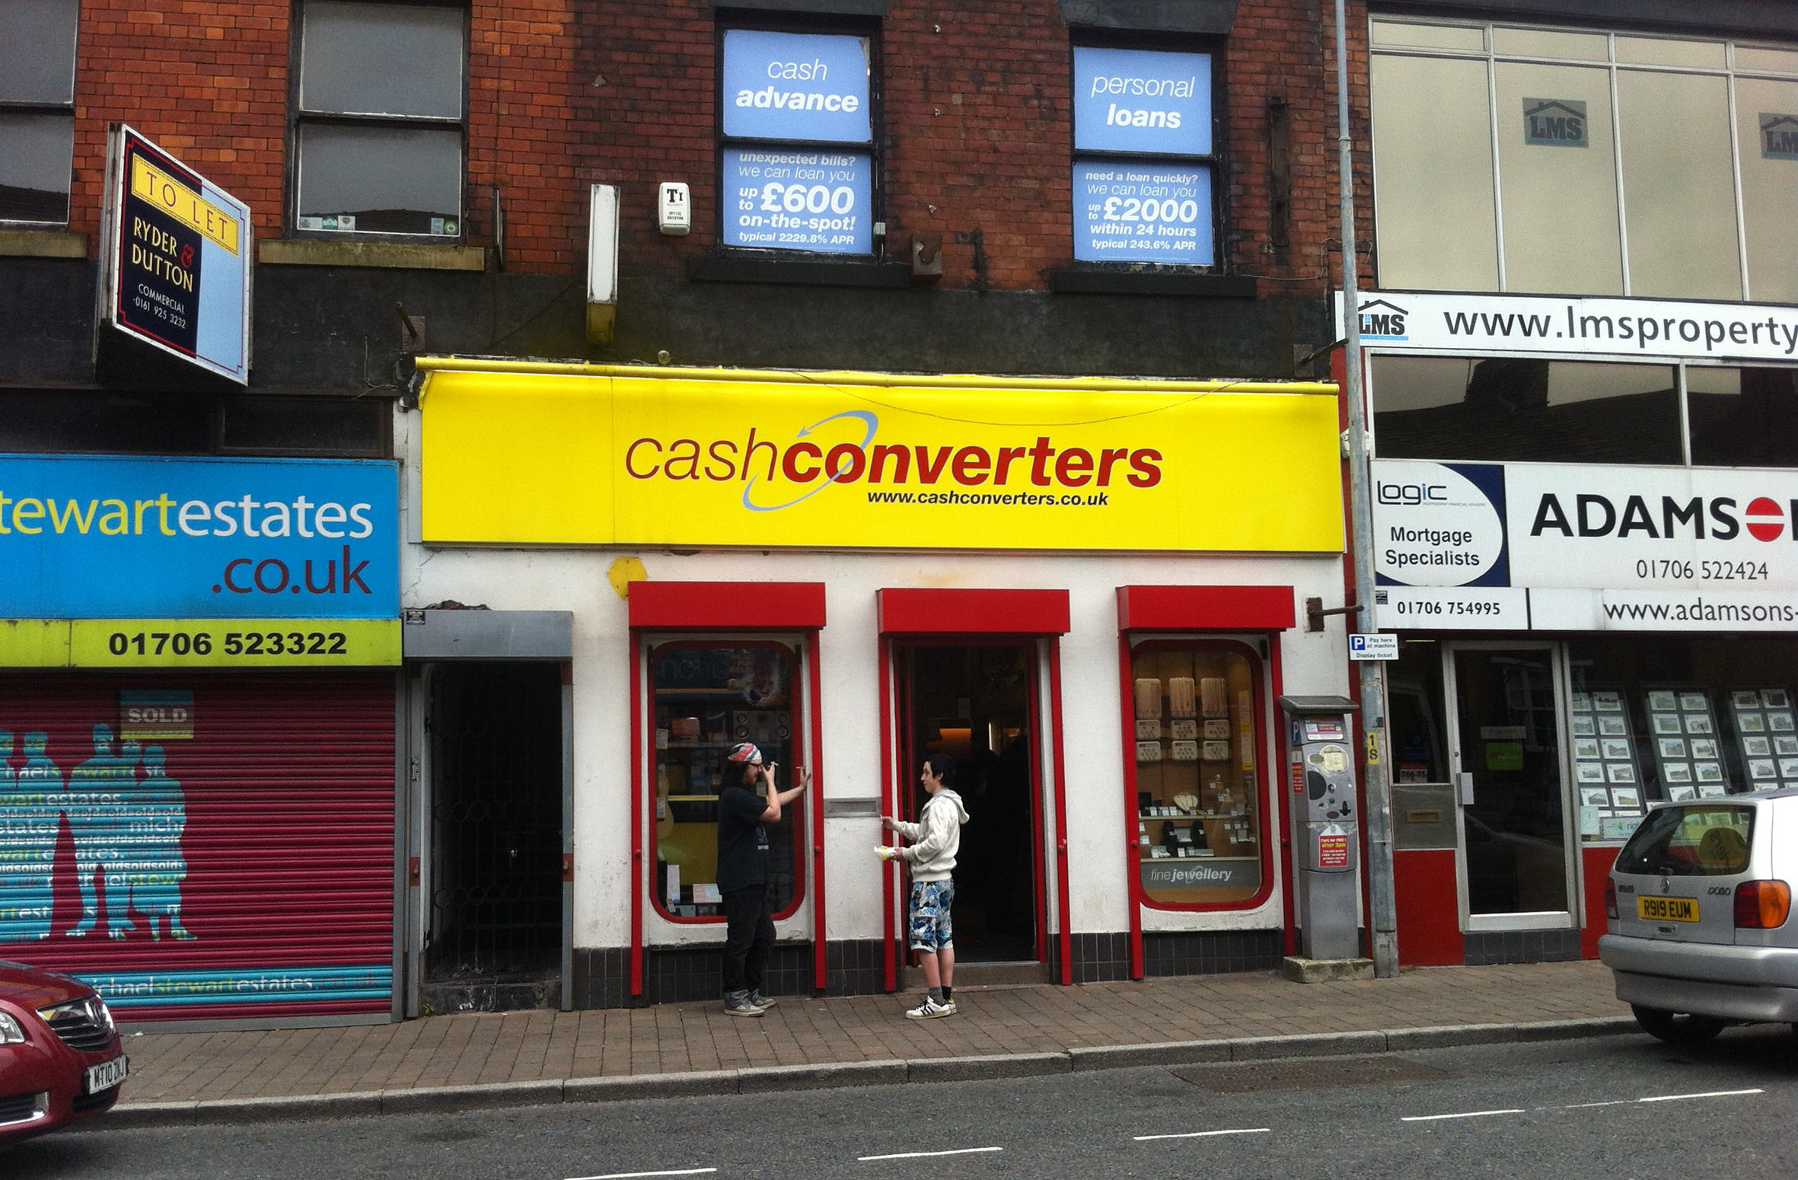
An already unfolding crisis

Slide 5
Structural change on the high street
More than one quarter of UK retail activity now takes place online
Traditional formats such as department stores are becoming obsolete
60,700 UK stores have closed in the last four years, with more than 500,000 jobs lost to the retail sector

Slide 6
The Community Improvement Districts programme
7 pilot projects across England, funded by Power to Change and the Greater London Authority

Slide 7
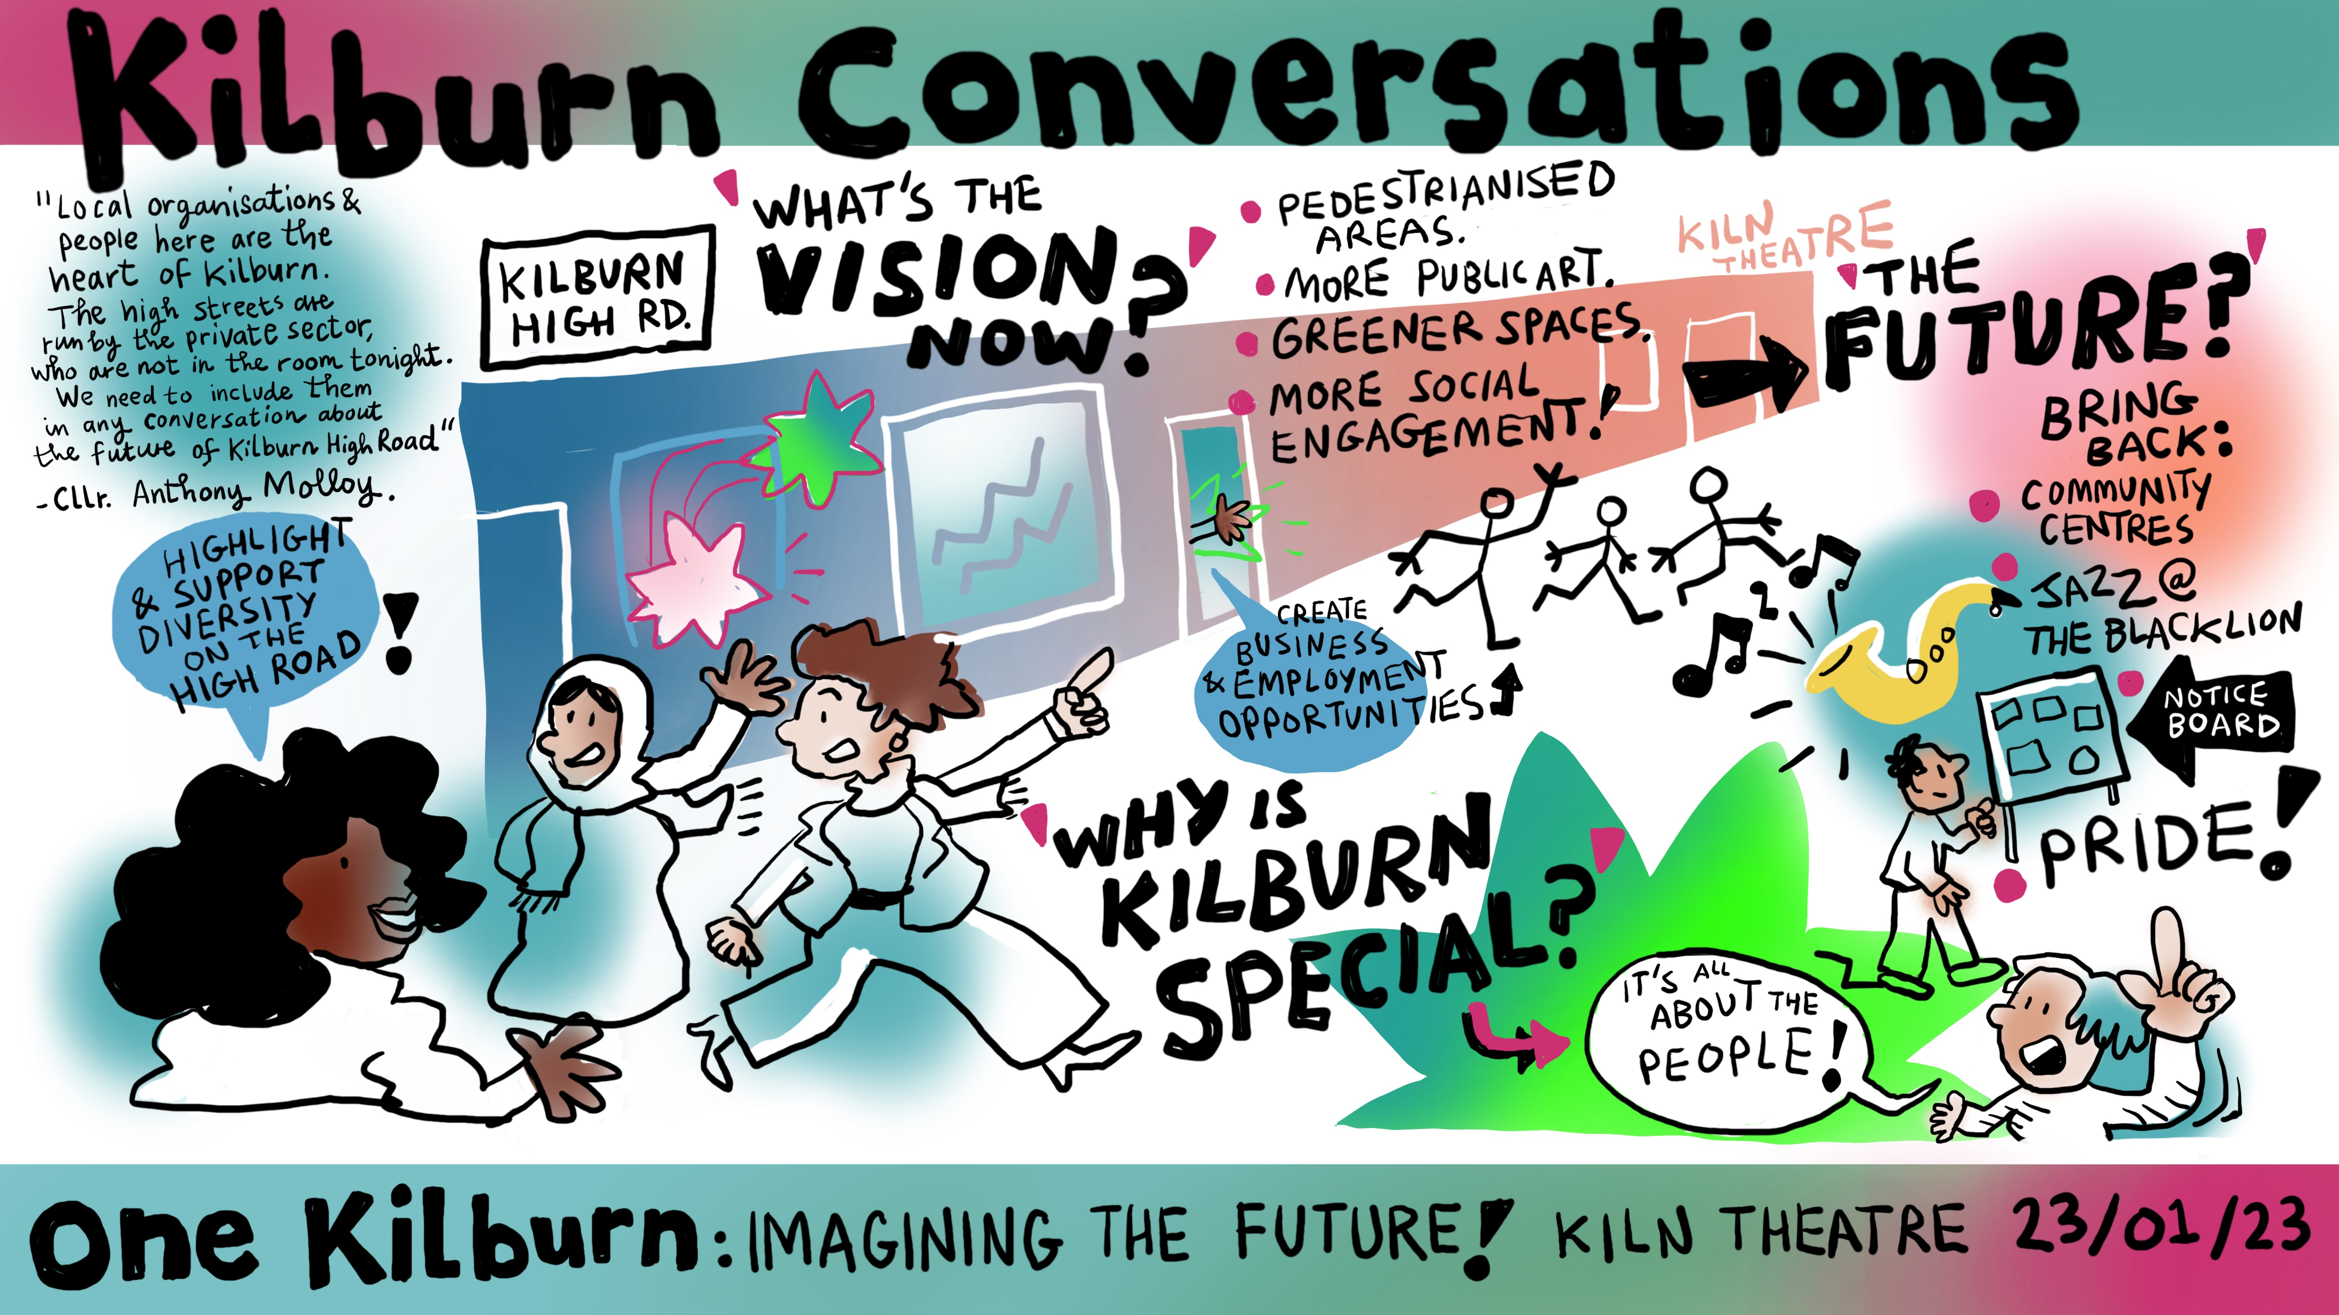
‘bodies which provide opportunities to participate in operational and strategic decision-making for their neighbourhoods’

Slide 8
About the seven pilots
Hendon, Sunderland. Established neighbourhood charity, high street focus.
Ipswich. Established BID, focused on wider town centre.
Kilburn, London. Local authority led, focus on neighbourhood high street.
Skelmersdale. New proposal, focus on town centre.
Stretford. Community business-led, focus on shopping centre redevelopment.
Wolverton. Established community benefit society, focus on shopping centre redevelopment.
Wood Green, London. BID, focus on neighbourhood centre.

Slide 9
Donella Meadows: twelve places to intervene in a system
A typology of system change interventions, from ‘shallow’ to ‘deep’ changes

Slide 10
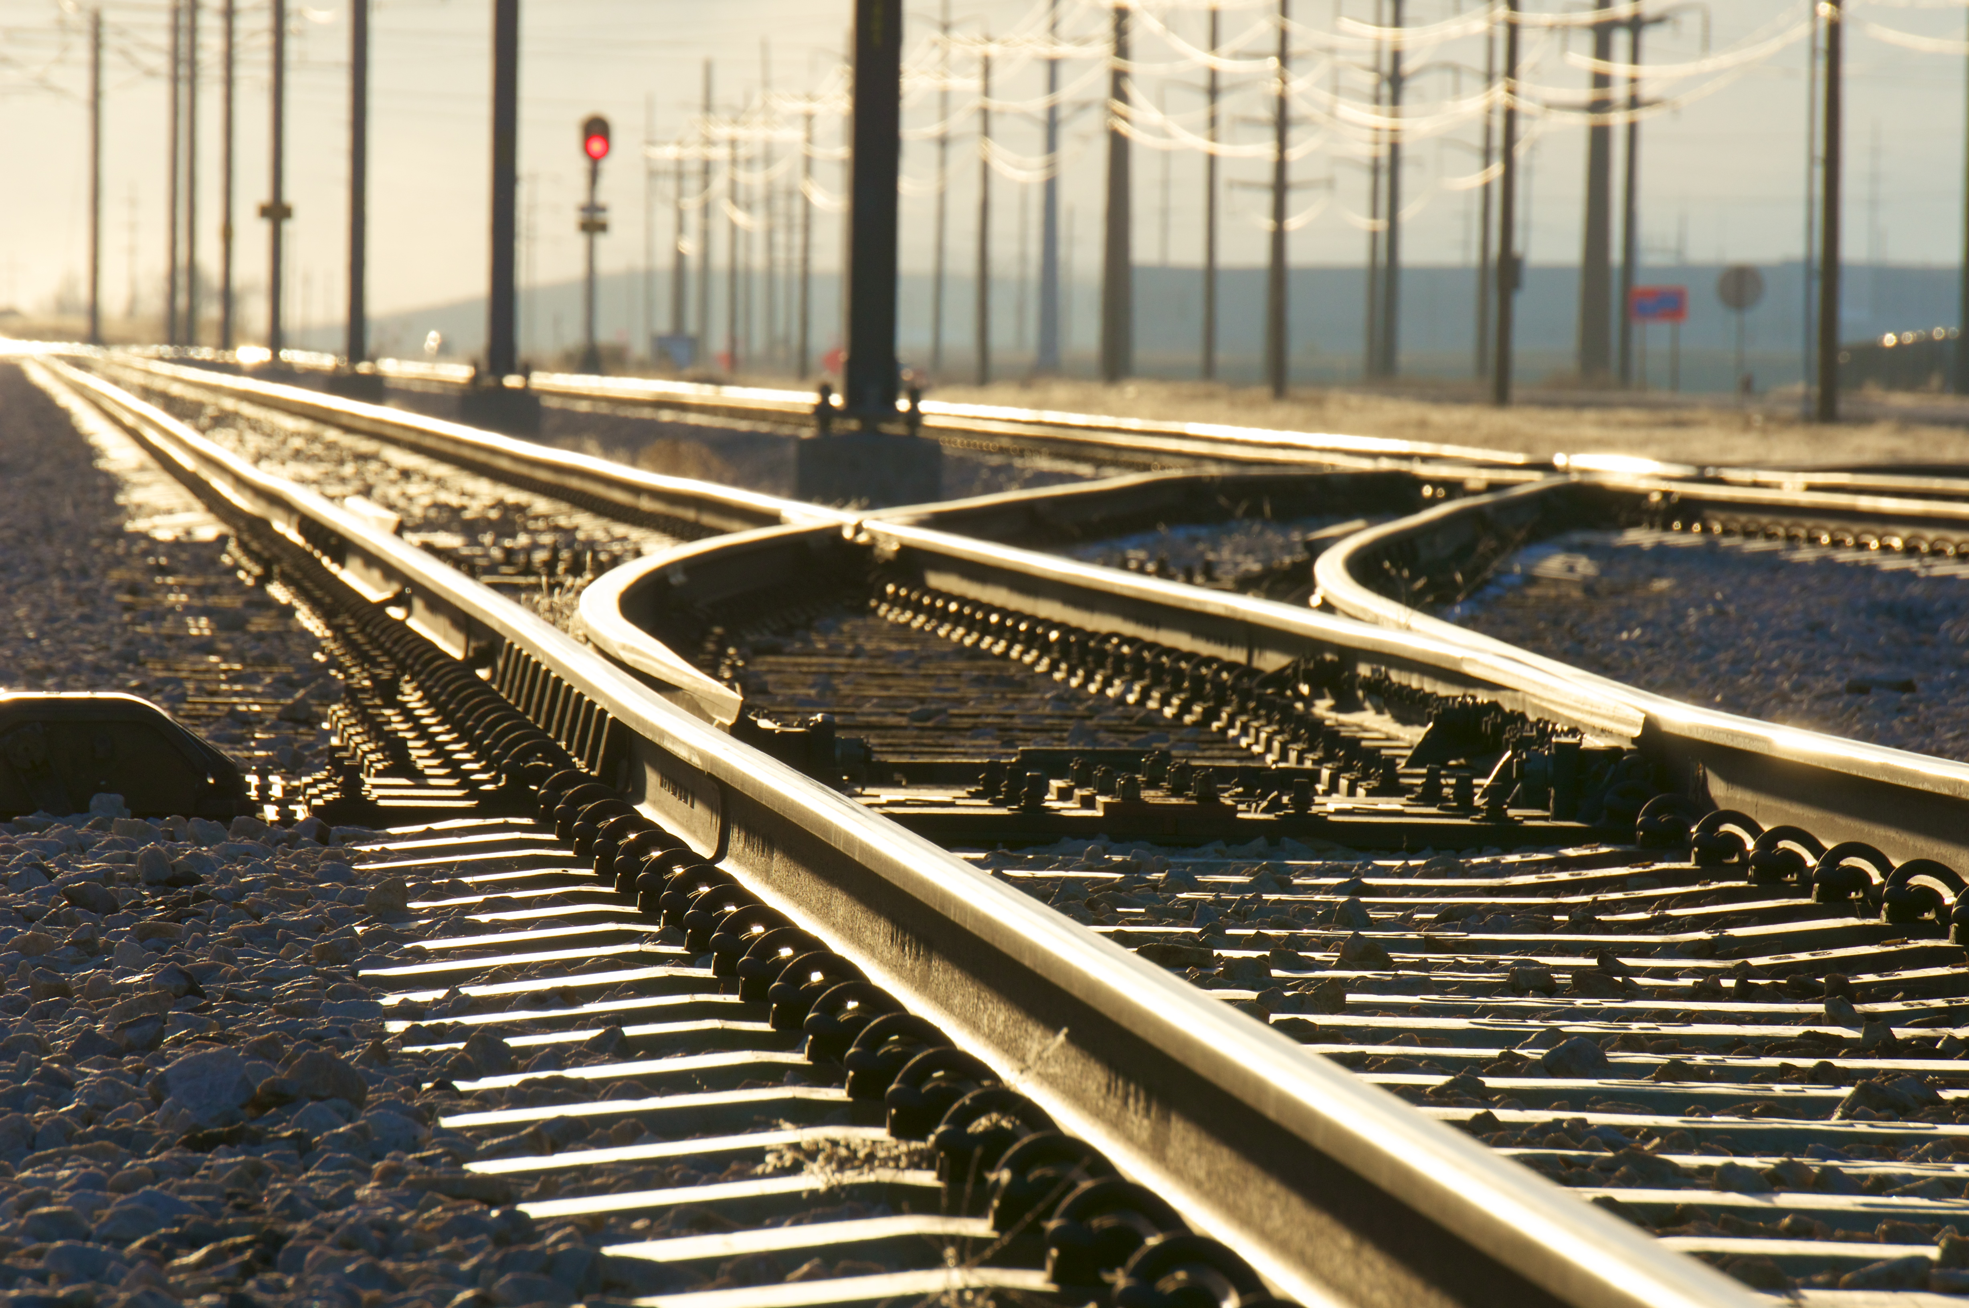
‘policy interventions and dominant scientific discourses mutually reinforce one another, meaning that shallower interventions are favoured both in science and policy’ (Abson et al., 2017)

Slide 11
PLACES TO INTERVENE IN A SYSTEM (in increasing order of effectiveness)
12. Constants, parameters, numbers (such as subsidies, taxes, standards).
11. The sizes of buffers and other stabilizing stocks, relative to their flows.
10. The structure of material stocks and flows (such as transport networks, population age structures).
9. The lengths of delays, relative to the rate of system change.
8. The strength of negative feedback loops, relative to the impacts they are trying to correct against.
7. The gain around driving positive feedback loops.
6. The structure of information flows (who does and does not have access to information).
5. The rules of the system (such as incentives, punishments, constraints).
4. The power to add, change, evolve, or self-organize system structure.
3. The goals of the system.
2. The mindset or paradigm out of which the system — its goals, structure, rules, delays, parameters — arises.
1. The power to transcend paradigms.
Meadows, D. H. (1999). Leverage points: Places to intervene in a system. http://donellameadows.org/archives/leverage-points-places-to-intervene-in-a-system/#seven

Slide 12
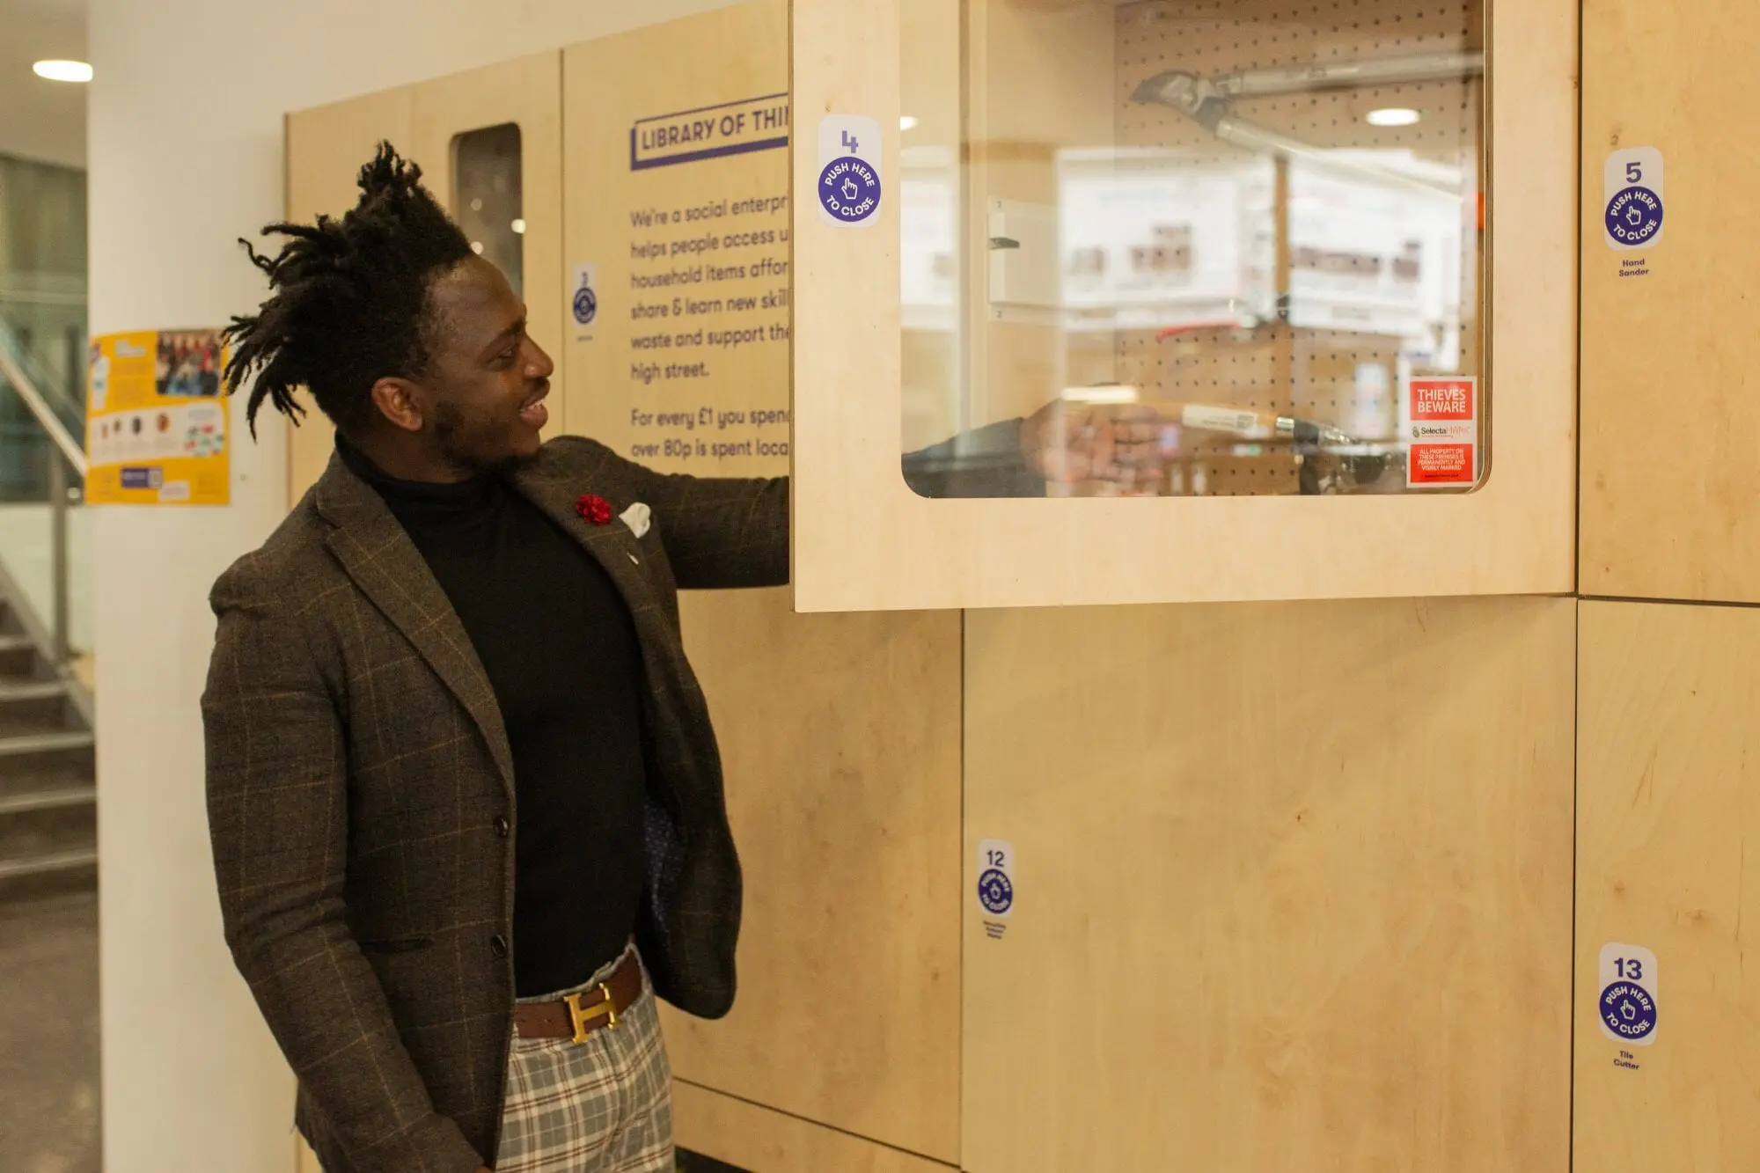
What the CIDs wanted, and what happened

Slide 13
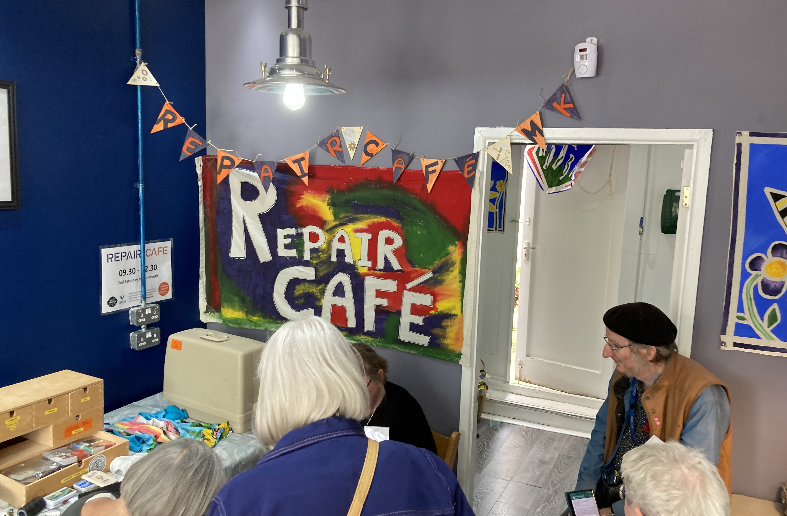
‘a community leadership and development approach to regenerating high streets’

Slide 14
Activities that could contribute to a net zero transition
New and improved green spaces
Repair, re-use and circular economy activities
Re-use and repurposing of buildings
Pedestrian-friendly highway use and traffic management
Community engagement and identifying community needs
Provision and animation of community spaces

Slide 15
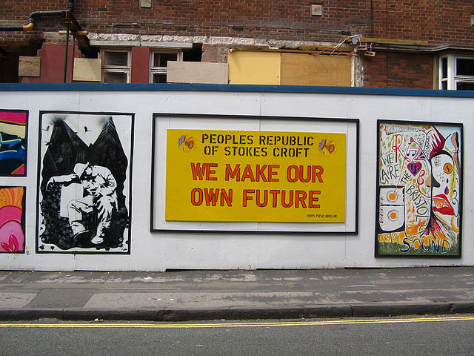
Reflections on CIDs and leverage points

Slide 16
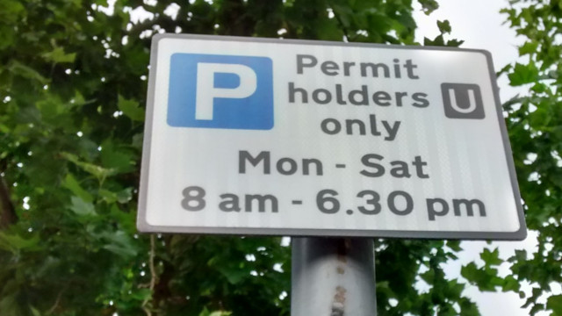
‘I’m working with a group of people who don’t really want to think about all the exciting stuff, they want to argue amongst one another about parking’
This Photo by Unknown Author is licensed under CC BY-NC-ND

Slide 17
What might leverage points look like in the light of the CID programme?
Places to intervene | Example interventions in high street transitions to net zero | Examples of relationship building required to sustain interventions
Constants, parameters, numbers | Identify zones for interventions or new uses | Closer links between planning and third sector
The sizes of buffers and other stabilizing stocks, relative to their flows | Support local markets and footfall through (e.g.) residential conversions | Deeper relationships between landowners, community and planners
The structure of material stocks and flows | Increase mix and diversity of uses and property types; redesign urban space for active travel and sociability | Deeper relationships between planners, property owners, public space managers and potential users

Slide 18
What might leverage points look like in the light of the CID programme?
Places to intervene | Example interventions in high street transitions to net zero | Examples of relationship building required to sustain interventions
The lengths of delays relative to the rate of system change | Disincentivise long-term empty property ownership; fast-track planning for community assets | Closer links between planning and civic society organisations
The strength of negative feedback loops, relative to the impacts they are trying to correct against | Mitigate urban heating and flooding with shade and green space | Build understanding between climate scientists and planners
The gain around driving positive feedback loops | Sustained and support community organisations to develop mature revenue streams and business models | Build capacity of third sector organisations to enable them to take on asset portfolios

Slide 19
What might leverage points look like in the light of the CID programme?
Places to intervene | Example interventions in high street transitions to net zero | Examples of relationship building required to sustain interventions
The structure of information flows | Open property data; participatory decision-making | Closer links between data scientists and planners
The rules of the system | Plan to incentivise adaptability and innovation while preserving assets of local value | Deeper and more open relationships between planners and potential users of built and public spaces
The power to add, change, evolve, or self-organize system structure | The relationships within the system – the confidence and ability to adapt, based on mutual support and trust | Invest in community development and capacity building; widen participation in governance systems

Slide 20
What might leverage points look like in the light of the CID programme?
Places to intervene | Example interventions in high street transitions to net zero | Examples of relationship building required to sustain interventions
The goals of the system | High streets as social spaces that are resilient and adaptable | Closer relationships between national and local policies and community aspirations
The mindset or paradigm out of which the system arises | High streets are centres of communities, not just centres of commerce | Greater community involvement in goal-setting, participatory policymaking
The power to transcend paradigms | 'The high street' as the local hub for net zero transition? | How can relationships with future generations and the more-than-human become part of our discourses and governance?

Slide 21
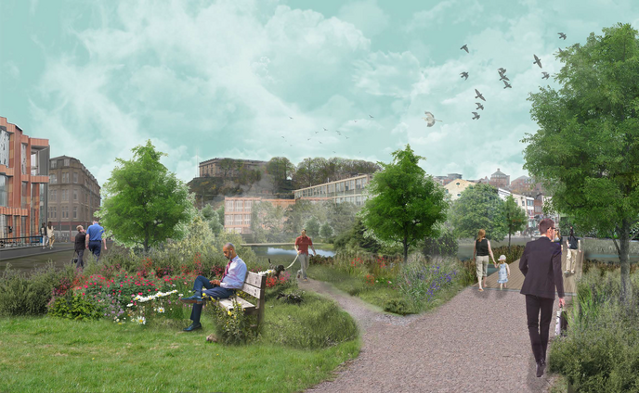
An emerging research agenda

Slide 22

Social spaces in a climate-changed world Relationship-building for net zero Local resilience and adaptability Land ownership and urban design for adaptation Biodiversity, future generations and the more-than-human

