Slide 1
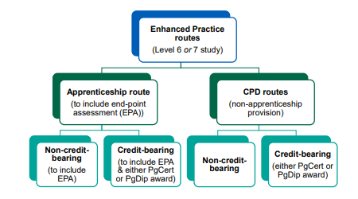
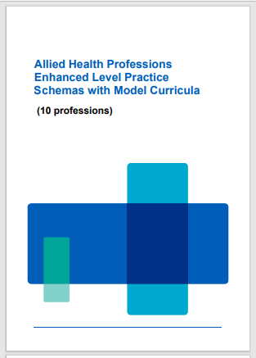
Leading development schemas and model curricula through collaboration and sustainable approaches.
Melanie Clarkson. Sheffield Hallam University. m.clarkson@shu.ac.uk Louise Henstock. University of Salford. l.henstock@salford.ac.uk . Dr Kim Stuart. Coventry University. ad5603@coventry.ac.uk
Introduction
NHS England commissioned the development of schemas and model curricula to support the development of allied health profession-specific programmes to increase the scope of the delivery of the Enhanced Clinical Practitioner apprenticeship and to elevate those professions where there is less accredited training available at this level of practice.
Aims
Develop profession specific schema and model curricular for 10 allied health professions.
Details of project
Each commissioned group developed individual collaborative innovation partnerships inclusive of:
Collectively the four commissioning partners worked collaboratively to provide transformative and innovative educational frameworks to support workforce reform through sustainability.
Figure 2. Enhanced Level Practice schema: open framework for Enhanced Level Practice.
Impact
To maximise autonomous practice as AHPs.
To be values-led at all levels of practice.
To be inclusive of all.
To be multi-professional in intent but celebrate clarity and depth of practice that is profession specific.
To be agile in design across health and care.
To commit to transformational change at system, place, and neighbourhood levels.
To be aligned to existing educational frameworks and curricula.
To be cognisant of professionals’ career journey from registration to Advanced Levels of Practice and beyond.
To be employer-led to grow and sustain the local workforce who are representative of the community they serve.
Conclusion
Socialisation of enhanced practice and its relation to advanced practice is now important to ensure correct implementation with the NHS and Social Care workforce.
Figure 3.
Figure 1.
Collaborative Innovation Partnership
Professional Bodies
Four nation representation
Professional Practice
HEI
Workforce leads
References
NHS England (2024) Allied Health Professions Enhanced Level Practice Schemas
with Model Curricula.
https://www.hee.nhs.uk/sites/default/files/documents/Enhanced-Level%20Practice%20AHP%20Schema%20Combined%20-%20Final%20May%202024%20%5Bfor%20pdf%20website%20upload%5D.pdf
Acknowledgments
Claire Arditto. National AHP Enhanced Practice Apprenticeship Programme Lead. Regional Head of Allied Health Professions North-East and Yorkshire

Slide 2
Leading development schemas and model curricula through collaboration and sustainable approaches.
Melanie Clarkson. Sheffield Hallam University. m.clarkson@shu.ac.uk Louise Henstock. University of Salford. l.henstock@salford.ac.uk . Dr Kim Stuart. Coventry University. ad5603@coventry.ac.uk
Introduction
NHS England commissioned the development of schemas and model curricula to support the development of allied health profession-specific programmes to increase the scope of the delivery of the Enhanced Clinical Practitioner apprenticeship and to elevate those professions where there is less accredited training available at this level of practice.
Aims
Develop profession specific schema and model curricular for 10 allied health professions.
Details of project
Each commissioned group developed individual collaborative innovation partnerships inclusive of:
Collectively the four commissioning partners worked collaboratively to provide transformative and innovative educational frameworks to support workforce reform through sustainability.
Figure 2. Enhanced Level Practice schema: open framework for Enhanced Level Practice.
Impact
To maximise autonomous practice as AHPs.
To be values-led at all levels of practice.
To be inclusive of all.
To be multi-professional in intent but celebrate clarity and depth of practice that is profession specific.
To be agile in design across health and care.
To commit to transformational change at system, place, and neighbourhood levels.
To be aligned to existing educational frameworks and curricula.
To be cognisant of professionals’ career journey from registration to Advanced Levels of Practice and beyond.
To be employer-led to grow and sustain the local workforce who are representative of the community they serve.
Conclusion
Socialisation of enhanced practice and its relation to advanced practice is now important to ensure correct implementation with the NHS and Social Care workforce.
Figure 3.
Figure 1.
Collaborative Innovation Partnership
Professional Bodies
Four nation representation
Professional Practice
HEI
Workforce leads
References
NHS England (2024) Allied Health Professions Enhanced Level Practice Schemas
with Model Curricula.
https://www.hee.nhs.uk/sites/default/files/documents/Enhanced-Level%20Practice%20AHP%20Schema%20Combined%20-%20Final%20May%202024%20%5Bfor%20pdf%20website%20upload%5D.pdf
Acknowledgments
Claire Arditto. National AHP Enhanced Practice Apprenticeship Programme Lead. Regional Head of Allied Health Professions North-East and Yorkshire

Slide 3
Leading development schemas and model curricula through collaboration and sustainable approaches.
Melanie Clarkson. Sheffield Hallam University. m.clarkson@shu.ac.uk Louise Henstock. University of Salford. l.henstock@salford.ac.uk . Dr Kim Stuart. Coventry University. ad5603@coventry.ac.uk
Introduction
NHS England commissioned the development of schemas and model curricula to support the development of allied health profession-specific programmes to increase the scope of the delivery of the Enhanced Clinical Practitioner apprenticeship and to elevate those professions where there is less accredited training available at this level of practice.
Aims
Develop profession specific schema and model curricular for 10 allied health professions.
Details of project
Each commissioned group developed individual collaborative innovation partnerships inclusive of:
Collectively the four commissioning partners worked collaboratively to provide transformative and innovative educational frameworks to support workforce reform through sustainability.
Figure 2. Enhanced Level Practice schema: open framework for Enhanced Level Practice.
Impact
To maximise autonomous practice as AHPs.
To be values-led at all levels of practice.
To be inclusive of all.
To be multi-professional in intent but celebrate clarity and depth of practice that is profession specific.
To be agile in design across health and care.
To commit to transformational change at system, place, and neighbourhood levels.
To be aligned to existing educational frameworks and curricula.
To be cognisant of professionals’ career journey from registration to Advanced Levels of Practice and beyond.
To be employer-led to grow and sustain the local workforce who are representative of the community they serve.
Conclusion
Socialisation of enhanced practice and its relation to advanced practice is now important to ensure correct implementation with the NHS and Social Care workforce.
Figure 3.
Figure 1.
Collaborative Innovation Partnership
Professional Bodies
Four nation representation
Professional Practice
HEI
Workforce leads
References
NHS England (2024) Allied Health Professions Enhanced Level Practice Schemas
with Model Curricula.
https://www.hee.nhs.uk/sites/default/files/documents/Enhanced-Level%20Practice%20AHP%20Schema%20Combined%20-%20Final%20May%202024%20%5Bfor%20pdf%20website%20upload%5D.pdf
Acknowledgments
Claire Arditto. National AHP Enhanced Practice Apprenticeship Programme Lead. Regional Head of Allied Health Professions North-East and Yorkshire

