Slide 1

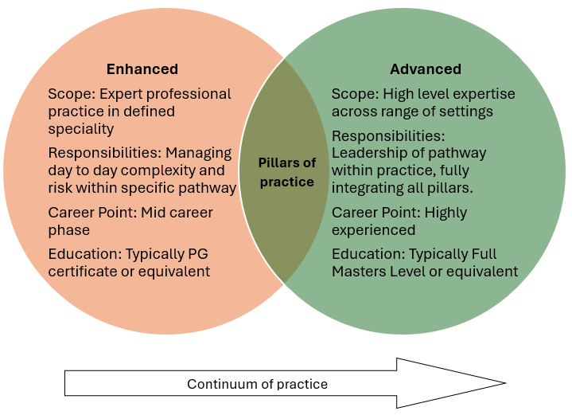




Sustainable provision of education in the transition from enhanced to advanced practice.
Melanie Clarkson. Sheffield Hallam University. m.clarkson@shu.ac.uk Louise Henstock. University of Salford. l.henstock@salford.ac.uk . Dr Kim Stuart. Coventry University. ad5603@coventry.ac.uk
Introduction
Enhanced practice is a valued level of practice, however, for some individuals, it may also be part of professional development towards advanced practice. It is acknowledged that there will be progression within these two levels of practice requiring the Academic Education Institution (AEI) to be able to work with individuals, employers, institutional policy, and regulatory frameworks to manage the consideration of the learning journey effectively.
Academic, and clinical levels of practice are two very different entities. It is important to recognise therefore how Level 7 learning supports the development and application of individual practitioners’ professional knowledge and skills in differentiating the two levels of practice. It is essential that robust and rigorous recognition of prior experience/ learning (RPE/L) should be enacted to uphold the quality of education to enable quality of education and training, in line with academic procedures within the transition toward advanced-level awards.
The development of guidance is to support AEI in considering RPE/L within the development and management of enhanced/advanced practice educational provision. In doing so wider consideration of the implications of these decisions is reflected
Development
Provision of supportive documentation to
Upholding quality and safety of patient care
Mitigating and managing risk within education and training.
Meeting service needs
Working within the professions and individual scope of practice
Through collaboration commissioned AEI and NHSE leads undertook work to provide supportive documentation of the RPE/L requirements from enhanced to advanced practice. This is of significance due to the risk of some provision and practitioners seeing advanced practice as enhanced with a dissertation and these are two very different levels of practice and therefore the transition should be more widely considered.
Figure 2.
Conclusion
A position statement will be released on behalf of NHSE with socialisation to clarify the difference in levels of practice and identify the RPE/L areas to be considered by AEI programmes.
Transition through education and training and levels of practice should be supported and encouraged, through safe and effective RPE/L. This position statement will provide clarity to ensure those seeking transition to advanced practice do this safely.
Figure 1. AHPs Capability Development
Acknowledgements
Claire Arditto. National AHP Enhanced Practice Apprenticeship Programme Lead. Regional Head of Allied Health Professions North-East and Yorkshire
References
NHS England (2024) Allied Health Professions Enhanced Level Practice Schemas with Model Curricula.
https://www.hee.nhs.uk/sites/default/files/documents/Enhanced-Level%20Practice%20AHP%20Schema%20Combined%20-%20Final%20May%202024%20%5Bfor%20pdf%20website%20upload%5D.pdf

Slide 2
Sustainable provision of education in the transition from enhanced to advanced practice.
Melanie Clarkson. Sheffield Hallam University. m.clarkson@shu.ac.uk Louise Henstock. University of Salford. l.henstock@salford.ac.uk . Dr Kim Stuart. Coventry University. ad5603@coventry.ac.uk
Introduction
Enhanced practice is a valued level of practice, however, for some individuals, it may also be part of professional development towards advanced practice. It is acknowledged that there will be progression within these two levels of practice requiring the Academic Education Institution (AEI) to be able to work with individuals, employers, institutional policy, and regulatory frameworks to manage the consideration of the learning journey effectively.
Academic, and clinical levels of practice are two very different entities. It is important to recognise therefore how Level 7 learning supports the development and application of individual practitioners’ professional knowledge and skills in differentiating the two levels of practice. It is essential that robust and rigorous recognition of prior experience/ learning (RPE/L) should be enacted to uphold the quality of education to enable quality of education and training, in line with academic procedures within the transition toward advanced-level awards.
The development of guidance is to support AEI in considering RPE/L within the development and management of enhanced/advanced practice educational provision. In doing so wider consideration of the implications of these decisions is reflected
Development
Provision of supportive documentation to
Upholding quality and safety of patient care
Mitigating and managing risk within education and training.
Meeting service needs
Working within the professions and individual scope of practice
Through collaboration commissioned AEI and NHSE leads undertook work to provide supportive documentation of the RPE/L requirements from enhanced to advanced practice. This is of significance due to the risk of some provision and practitioners seeing advanced practice as enhanced with a dissertation and these are two very different levels of practice and therefore the transition should be more widely considered.
Figure 2.
Conclusion
A position statement will be released on behalf of NHSE with socialisation to clarify the difference in levels of practice and identify the RPE/L areas to be considered by AEI programmes.
Transition through education and training and levels of practice should be supported and encouraged, through safe and effective RPE/L. This position statement will provide clarity to ensure those seeking transition to advanced practice do this safely.
Figure 1. AHPs Capability Development
Acknowledgements
Claire Arditto. National AHP Enhanced Practice Apprenticeship Programme Lead. Regional Head of Allied Health Professions North-East and Yorkshire
References
NHS England (2024) Allied Health Professions Enhanced Level Practice Schemas with Model Curricula.
https://www.hee.nhs.uk/sites/default/files/documents/Enhanced-Level%20Practice%20AHP%20Schema%20Combined%20-%20Final%20May%202024%20%5Bfor%20pdf%20website%20upload%5D.pdf

Slide 3
Sustainable provision of education in the transition from enhanced to advanced practice.
Melanie Clarkson. Sheffield Hallam University. m.clarkson@shu.ac.uk Louise Henstock. University of Salford. l.henstock@salford.ac.uk . Dr Kim Stuart. Coventry University. ad5603@coventry.ac.uk
Introduction
Enhanced practice is a valued level of practice, however, for some individuals, it may also be part of professional development towards advanced practice. It is acknowledged that there will be progression within these two levels of practice requiring the Academic Education Institution (AEI) to be able to work with individuals, employers, institutional policy, and regulatory frameworks to manage the consideration of the learning journey effectively.
Academic, and clinical levels of practice are two very different entities. It is important to recognise therefore how Level 7 learning supports the development and application of individual practitioners’ professional knowledge and skills in differentiating the two levels of practice. It is essential that robust and rigorous recognition of prior experience/ learning (RPE/L) should be enacted to uphold the quality of education to enable quality of education and training, in line with academic procedures within the transition toward advanced-level awards.
The development of guidance is to support AEI in considering RPE/L within the development and management of enhanced/advanced practice educational provision. In doing so wider consideration of the implications of these decisions is reflected
Development
Provision of supportive documentation to
Upholding quality and safety of patient care
Mitigating and managing risk within education and training.
Meeting service needs
Working within the professions and individual scope of practice
Through collaboration commissioned AEI and NHSE leads undertook work to provide supportive documentation of the RPE/L requirements from enhanced to advanced practice. This is of significance due to the risk of some provision and practitioners seeing advanced practice as enhanced with a dissertation and these are two very different levels of practice and therefore the transition should be more widely considered.
Figure 2.
Conclusion
A position statement will be released on behalf of NHSE with socialisation to clarify the difference in levels of practice and identify the RPE/L areas to be considered by AEI programmes.
Transition through education and training and levels of practice should be supported and encouraged, through safe and effective RPE/L. This position statement will provide clarity to ensure those seeking transition to advanced practice do this safely.
Figure 1. AHPs Capability Development
Acknowledgements
Claire Arditto. National AHP Enhanced Practice Apprenticeship Programme Lead. Regional Head of Allied Health Professions North-East and Yorkshire
References
NHS England (2024) Allied Health Professions Enhanced Level Practice Schemas with Model Curricula.
https://www.hee.nhs.uk/sites/default/files/documents/Enhanced-Level%20Practice%20AHP%20Schema%20Combined%20-%20Final%20May%202024%20%5Bfor%20pdf%20website%20upload%5D.pdf

