Slide 1
Upskilling the Next Generation of Nurses: Embracing Digital Literacy and Informatics in the UK
Presented by Leisa Anderton, Senior Lecturer in Nursing, Sheffield Hallam University

Slide 2
Overview
Technology is transforming healthcare.
Importance of preparing nurses for a digital healthcare landscape
Our role as educators in this transformation

Slide 3
The Evolving Role of Nursing in a Digital Healthcare System
• Digital Transformation in Healthcare
NHS: Integration of digital tools.
Technologies becoming commonplace:
Electronic Health Records (EHRs)
Telemedicine
Mobile health apps

Slide 4
Nurses as Data Stewards and Caregivers
Integral in data collection and analysis
Managing and securing patient data
Enhancing patient care through technology

Slide 5
Leadership in Digital Transformation
Nurses' influence on technology adoption
Empowering nurses with informatics knowledge
Leading effective changes in healthcare delivery

Slide 6
The Growing Importance of Digital Literacy
• Defining Digital Literacy
Using ICT to find, evaluate, create, and communicate information
•Essential cognitive and technical skills for modern nursing

Slide 7
Competency in Electronic Health Records
Efficient navigation of EHR systems
Accurate documentation and care planning
Understanding interoperability

Slide 8
Data Security and Ethical Considerations
Managing patient data securely
Compliance with GDPR
Maintaining patient confidentiality

Slide 9
Effective Use of Telehealth
Proficiency in telemedicine platforms
Providing virtual care
Integrating remote monitoring devices

Slide 10
Patient Education in Digital Health
Empowering patients with digital tools
Guiding use of health apps and devices
Enhancing health outcomes

Slide 12
Integrating Informatics into Nursing Education
Curriculum Design
Embedding informatics throughout programmes
Aligning education with digital healthcare realities

Slide 13
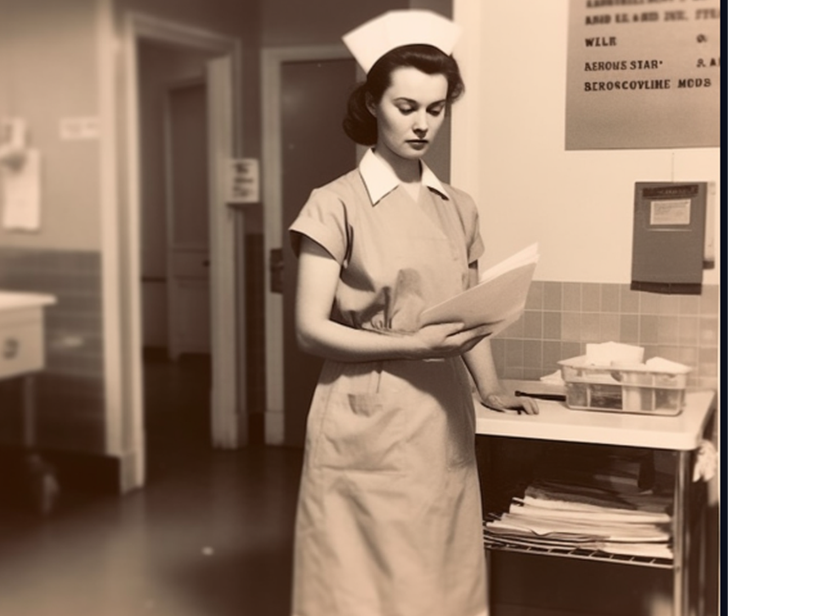

Slide 14
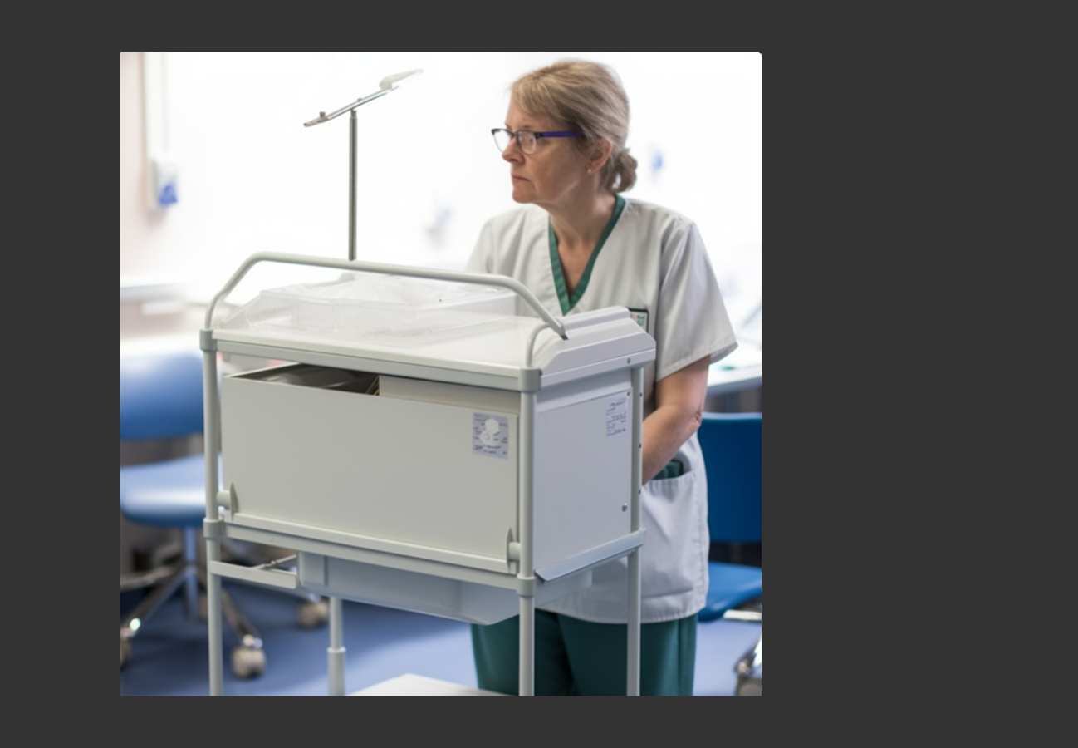

Slide 15
Simulation and Virtual Learning
Utilising simulation labs and VR
Practicing with digital tools in safe settings
Real-life clinical scenarios involving technology

Slide 16
Collaboration with Healthcare IT Specialists
Partnerships between students and IT professionals
Projects bridging clinical care and tech innovation

Slide 17
Preparing for the Future
•Key Skills for Nurses in Digital Health
Information management
Critical thinking and data interpretation
Interprofessional collaboration

Slide 18
Overcoming Challenges
• Variability in Digital Literacy
Addressing different competency levels
Providing tailored support

Slide 19
Access to Technology
Ensuring equitable access for all learners
Overcoming institutional disparities

Slide 20
Continuing Professional Development
Offering CPD courses on digital health
Encouraging lifelong learning

Slide 22
A Call to Action
• For Nurse Educators and Healthcare Leaders
Leading the change in education and practice
Collaborative efforts across disciplines
Investing resources in education and technology

Slide 23
Conclusion
• The future of healthcare in the UK is digital.
• Upskilling nurses in digital literacy improves patient care outcomes.
• Our responsibility to prepare nurses for the future
Invitation to embrace and lead this transformation
.

Slide 25
Thank You
I welcome any questions or discussions on this topic and I have provided my contact details below:
Leisa Anderton
L.anderton@shu.ac.uk
0114 2254437

Slide 26
References
• Health Education England. The Topol Review: Preparing the healthcare workforce to deliver the digital future
• Nursing and Midwifery Council (NMC), Standards for pre-registration nursing education.
• Royal College of Nursing (RCN), The Future Nurse: Leading the digital transformation
• GDPR Compliance in Healthcare.

