Slide 1




Making Links : Crafting Creativity and Collaboration
Author : Veronica Larasati – Independent Designer-Maker (Indonesia)
Maria Hanson – Reader in Jewellery & Metalwork (Sheffield Hallam University - UK)
Laura Cave – Director (Just Trade - UK)
Dr Ellya Zulaikha – Head of Product Design (ITS – Indonesia)
THE IMPORTANCE OF LOCAL CONTEXT IN THE CO-DESIGN OF COLLABORATIVE FRAMEWORKS AND SIGNALLING SUSTAINABLE VALUE
FUTURING CRAFT IOTA21 CONFERENCE
17- 19 September 2021
Curtin University
Perth, Australia
Notes:
Vero
Good afternoon everyone who took part in this conference in Australia and in other parts of the world, welcome to the presentation of our paper entitled :
Making Links: Crafting Creativity and Collaboration
(15 seconds)

Slide 2
“Craft and Craft-making has the capacity to empower. It inhabits everyday life through both action and object, manifesting itself in functional, decorative and symbolic objects that reveal stories of cultures, identity and place”
Notes:
Vero
Craft and Craft-making has the capacity to empower. It inhabits everyday life through both action and object, manifesting itself in functional, decorative and symbolic objects that reveal stories of cultures, identity and place.
The idea of craft-making is seen as a way to reconnect the mind and body; with the buying of craft often signifying a desire for authenticity, for experiences, and for ethical and sustainable consumption. Within the socio-economic landscape of emerging and developing countries, Craft is one of the significant employment categories after agriculture, with a great deal of activity existing within the informal economy.
(45 seconds)

Slide 3
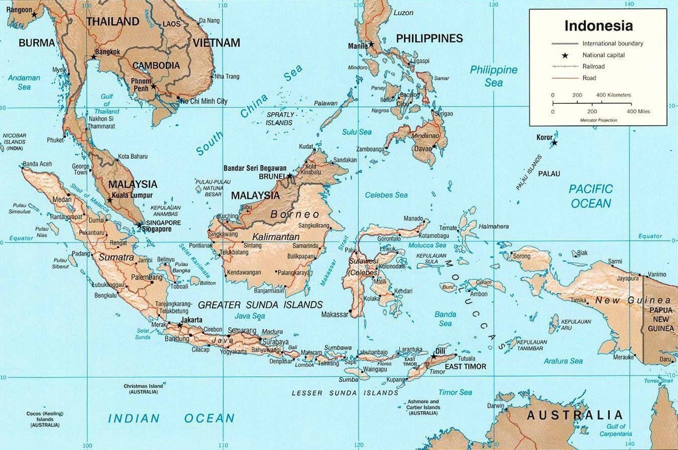

LIVING IN East Java Indonesia, in a town named Sidoarjo.
GRADUATED FROM ITS Surabaya, East Java
CURRENTLY a freelance designer-maker
Notes:
Vero
My name is Veronica Ajeng Larasati, I am an Indonesian, living in a town named Sidoarjo, a suburban regency near Surabaya, the capital city of East Java. I’m a graduate designer from Sepuluh Nopember Institute of Technology (ITS, Surabaya) and currently work as a freelance designer-maker.
(25 seconds)

Slide 4
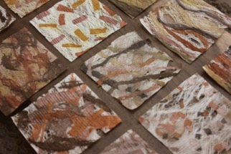
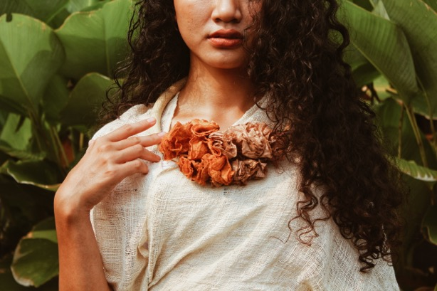
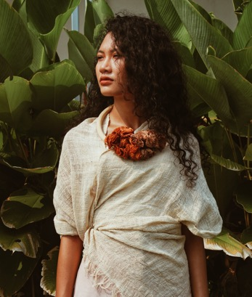
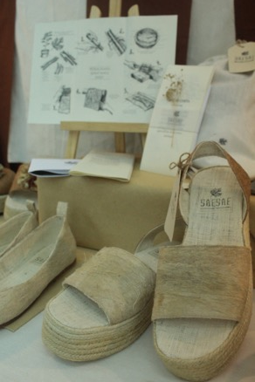
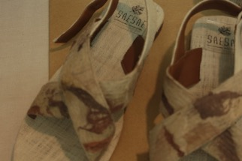
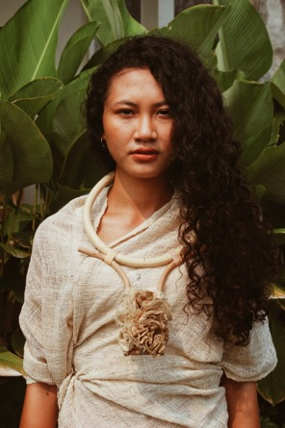
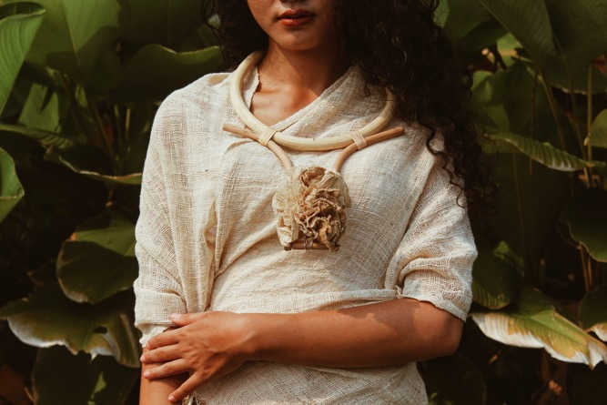
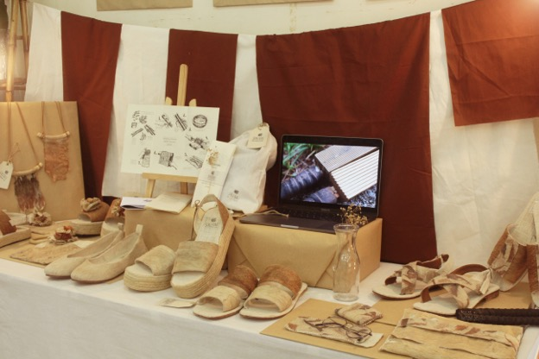
Notes:
Vero
As a designer-maker, I have a passion for exploring sustainable local crafts. My works are related to textile-based products ranging from fashion apparel to jewelry.
In my graduate project, I designed a range of fashion apparel products (shoes and pouch) and also jewelry using a natural fiber called “Daluang”, a textile material made of beaten bark from paper mulberry plants.
(30 seconds)

Slide 5
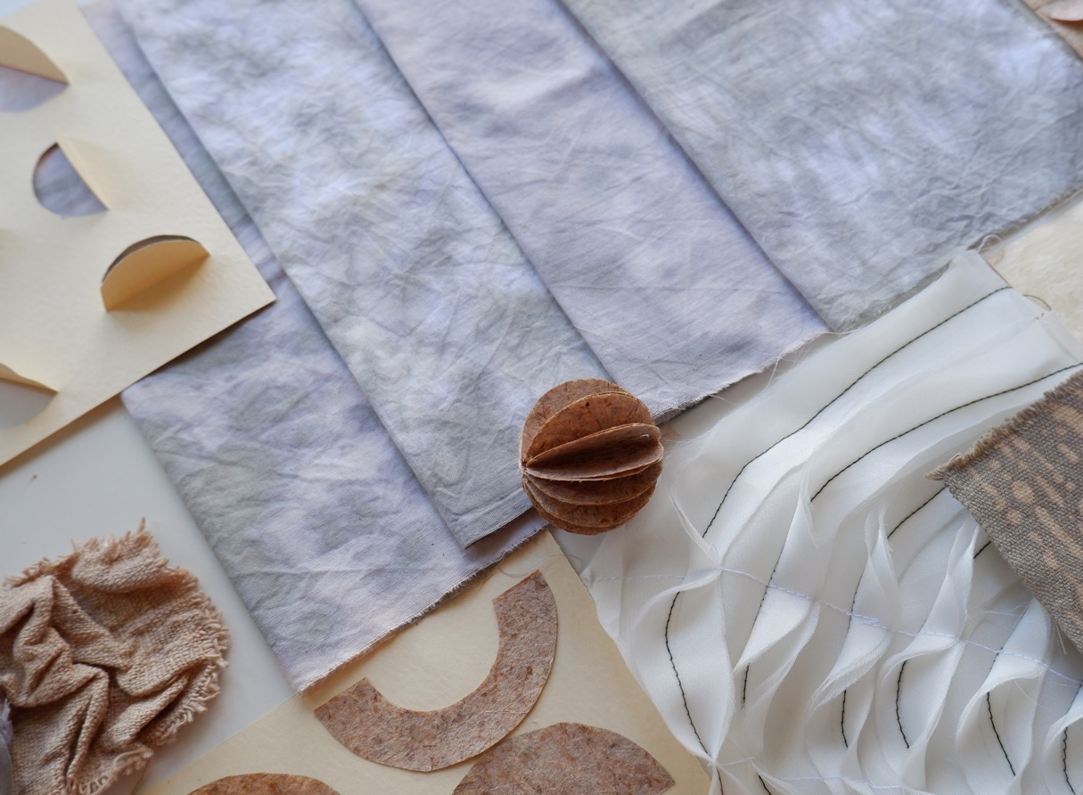
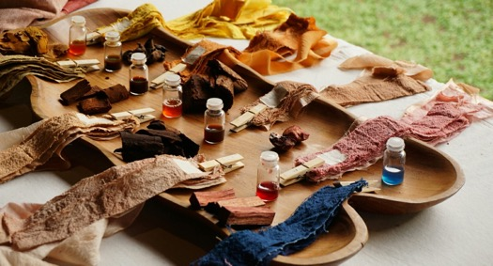
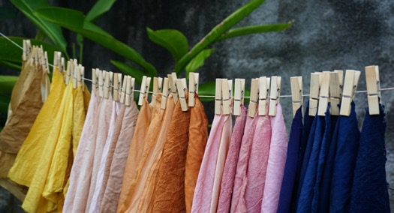
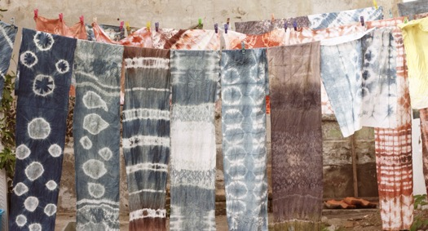
Notes:
Vero
I am so fascinated by the delicate nature of natural fibers and colors. In my practices, before I design the final product, the phase I enjoy the most is getting to know the character of the materials. Exploring its texture, color, shape, and all subtle qualities unseen to the eye, which only can be found through the art of making.
Thinking through making is embedded in my practices as it enables all my senses (mind and body) so I can get a deeper understanding of each material and unexpected ideas come from there.
(35 seconds)

Slide 6
Making Links Projects
Making Links 5 is a collaborative project. It aims to offer accessible tools for artisan craft makers by teaching design thinking through making in co-creative, collaborative environments, underpinned by the principles of fair trade.
AIM
OBJECTIVE
AMBITION
Notes:
Vero
Making Links 5 is a collaborative project. It aims to offer accessible tools for artisan craft makers by teaching design thinking through making in co-creative, collaborative environments, underpinned by the principles of fair trade. Through the introduction of creative methods for the innovative development of unique craft items for an international market, the approach taken harnesses existing skills, promotes artisanal sharing of knowledge and provides opportunities to learn new skills.
AIM to improve the cultural and economic livelihoods of craft makers
OBJECTIVE to develop and strengthen linkages and collaboration between craft makers, graduate designers, design researchers, fair trade agents and fair trade export wholesalers.
AMBITION to establish a sustainable model / system for a long- term fair trade route to market (including export) through collaborative practices in the development of new artisan craft products.
(1 minutes 15 seconds)

Slide 7
Design toolkits
for artisan craftmakers
Notes:
Vero
The Making Links 5: research project is set within the context of the United Nations eighth sustainable development goal, which promotes inclusive and economic growth, employment and decent work for all. It responds to the specific targets which support entrepreneurship, creativity and innovation in order to encourage the growth of micro, small and medium enterprises in the promotion of local culture and products.
(25 seconds)

Slide 8
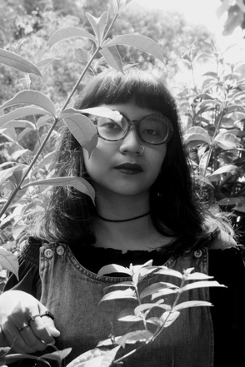
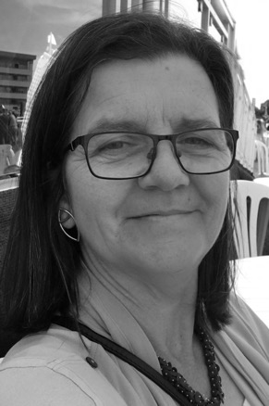
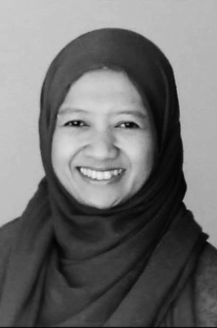
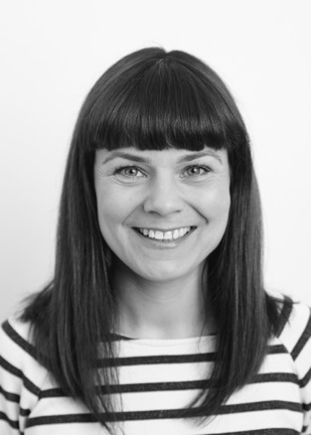
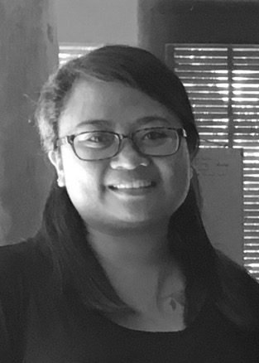
Veronica Larasati
Maria Hanson
Dr Ellya Zulaikha
Laura Cave
Kadek Febry
Notes:
Vero
The collaborative team of five women from the UK and Indonesia bring a wealth of knowledge about design thinking, jewellery-making, fair trade, collaborative learning, craft cooperatives and International export.
Veronica Larasati is a Graduate Designer from ITS in Surabaya, East Java, Indonesia. She is an independent designer who is interested in exploring sustainable local crafts and worker co-operatives.
Maria Hanson is a designer, craft maker and academic. She is Reader in Jewellery & Metalwork at Sheffield Hallam University, in the UK where she leads the Post-graduate design programme.
Dr Ellya Zulaikha is Vice Dean of the Creative and Digital Business Faculty at ITS, Surabaya, East Java. She has been involved in the development program for rural and urban craft in East Java, for more than fifteen years.
Laura Cave is a jewellery designer with over 20 years’ experience working co-creatively with artisan craft makers in emerging economies. She is the founder and director of Just Trade Ltd, who are dedicated to working with disadvantaged producer groups in order to provide long-term market access for their work.
Febry Kadek is an Indonesian Craft agent in Ubud, Bali with a wealth of local knowledge. She worked for a number of years as the Co-ordinator and translator for the Tungjung Women’s Creative Project.
(85 seconds)

Slide 9


Research England allocated SHU £200k
QR Global Challenges Research Funding (GCRF) for 2018-19.
SHU three-year GCRF strategy. Projects to fall under four beacons:
Beacon 1: Gender, Violence and Human Rights
Beacon 2: Sustainable Food Production
Beacon 3: Empowering through Creative Practice
Beacon 4: Health Inequalities
Notes:
Maria
The Making Links project has been supported by Research England‘s, Global Challenge Research Fund for 3 consecutive years.
This fund forms part of the UK’s ODA Committee’s agenda, to support research that addresses challenges faced by developing countries. It is administered by a number of delivery partners which includes the UK’s Research Institutes.
Sheffield Hallam University (SHU) was one of the recipients of this fund and its mission to ‘transform lives’ has undertaken research that generates social, economic and cultural benefits that align to thriving and inclusive communities and ‘Future Economies’.
Making Links 5 sits within the beacon of Empowering through Creative Practice which has at its heart co-creation as inquiry to promote empathy and understanding of the needs of marginalized communities.
(54 seconds)

Slide 10
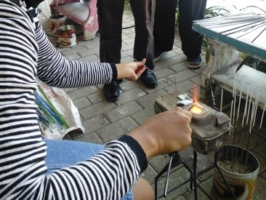
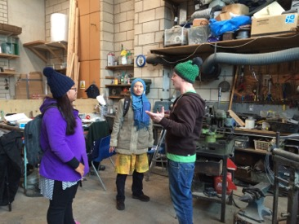
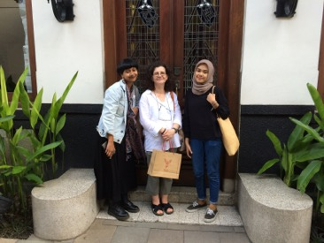
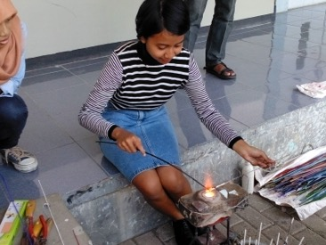
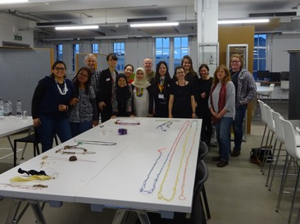
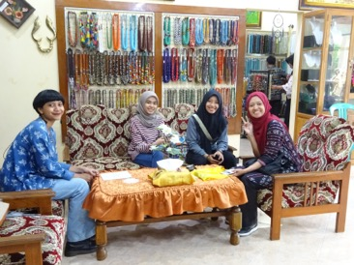
2015
2017
2018
Ellya organised a Collaborative workshop with design students and Artisan Bead-makers. Vero was a participant.
Ellya and Febri participated in AHRC in Create – Connect – Sustain Project in the UK and meet Maria & Laura
Maria’s first trip to Indonesia. Meets Vero and visits the Jombang Beads Industry
Notes:
Maria
The network of events that established our project team began in 2015 when Ellya organised a Collaborative workshop with design students from ITS and Artisan Beadmakers in Jombang. Vero was a participant.
Then in 2017 a Sheffield Hallam University, AHRC funded project, provided the opportunity for Ellya and Febry to visit the UK to expand knowledge and networks. This coincided with the 2017 Spring Fair in Birmingham where they met Maria and Laura. The Spring Fair provided the opportunity for Ellya and Febry to see first-hand how crafted products from Indonesia were being marketed and sold within an international context.
Maria’s first visit to East Java and Bali in 2018 connected her with Vero and allowed her to experience the social and cultural context that future activities could be situated in.
(50 seconds)

Slide 11
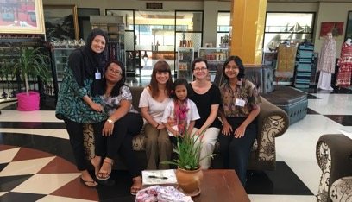
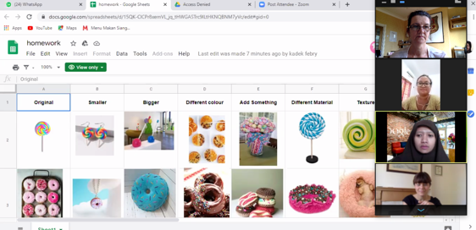
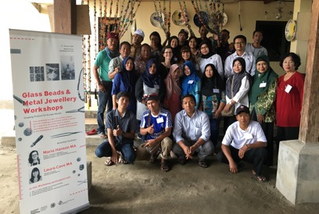
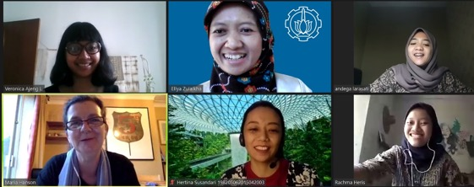
2019
2020-2021
The Team delivered their first project together in Jombang, East Java.
Due to the Covid-19 Pandemic, the team continue the project activities virtually
Notes:
Maria
In 2019 the team delivered their first co-creative workshop project together in Jombang, East Java supported by the Global Challenge Research Fund. The outcomes of which will be shown later.
Unfortunately, further physical workshops were prevented due to the Covid-19 pandemic.
The team responded through digital online activities, and in 2020-21 delivered a series of workshops not only in East Java but with artisans in Ecuador and Peru.
(26 seconds)

Slide 12
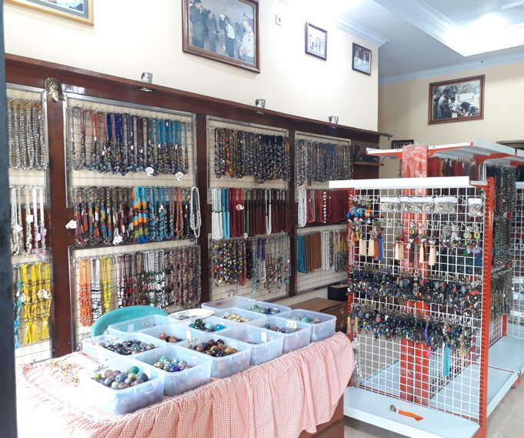
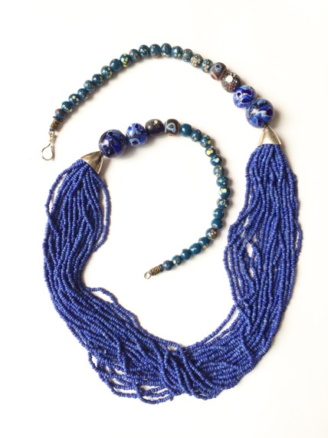
Background Story
Notes:
Vero
1.Current condition of marginalized craft-maker
Craft-makers (also referred to as craft producer / workers / artisans) within developing country contexts have specialist craft-making skills, / they do not often have creative design, marketing and entrepreneurial skills and as a consequence remain in a marginalized position within the craft value chain.
Artisans often rely on copying existing products because of a lack of confidence and inability to integrate ideas with market needs.
2. Aim
To sustain craft futures in this area, with the envisioned concept of sustainable partnerships through capacity-building workshops that open up wider market opportunities.
(55 seconds)

Slide 13
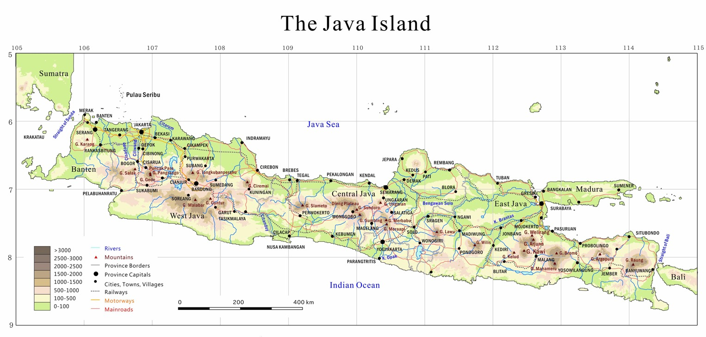
JOMBANG GLASS BEAD CRAFT INDUSTRY
SURABAYA
(Capital City, ITS)
Notes:
Vero
In East Java, there is an established glass beads craft Industry, it’s located in Jombang (90 km from Surabaya). The glass beads industry has been there since 1970.
I’ve known about glass beads for quite a long time, but I didn't realize that there is a glass beads craft industry around my region. My initial encounter with the Jombang Glass Beads was when I participated in a collaborative workshop (organised by Ellya) in college. I was mind-blown by the intricate process of how the beads were made one by one by hand.
(40 seconds)

Slide 14
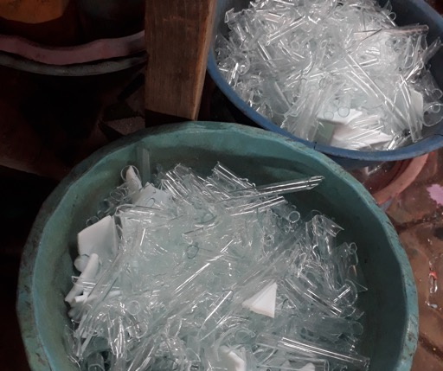
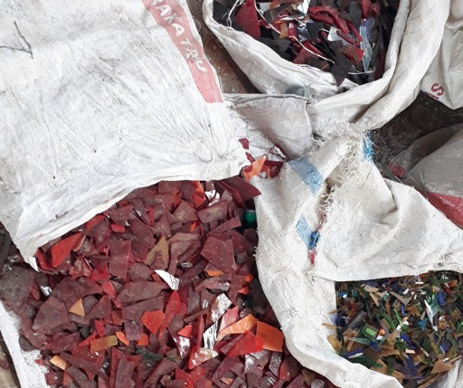
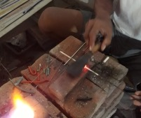
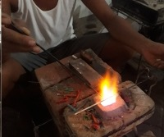
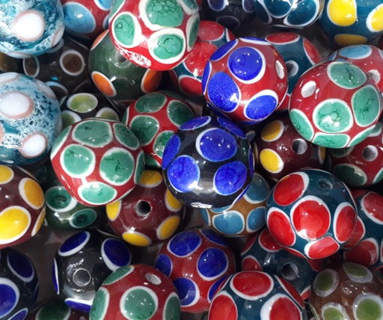
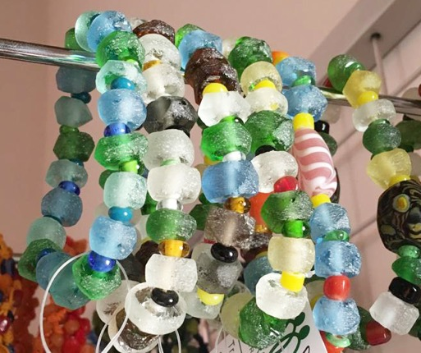
Notes:
Vero
Glass beads are beads made of wasted materials, like clear glass, colored glass, or porcelain. The raw material then melted, colored, and turned into thin glass sticks. From there, the bead-makers create the desired shape and color one by one by hand devised with traditional tools. We can create a glass bead with endless variations of shape and color.
Because of the influence of fashion trends, the Industry reached its peak sales in the 2000s. However, the demands mostly come from ancient beads lovers who asked for replicas of tribal beads. Sadly, the demand started to decline in 2010.
To stimulate product innovations amongst the glass beads craft industry, for the industry to sustain, creative design skills supported by market knowledge are needed to generate new product ideas.
(55 seconds)

Slide 15
Co-Creative Workshop: Jombang, East Java 2019

Slide 16
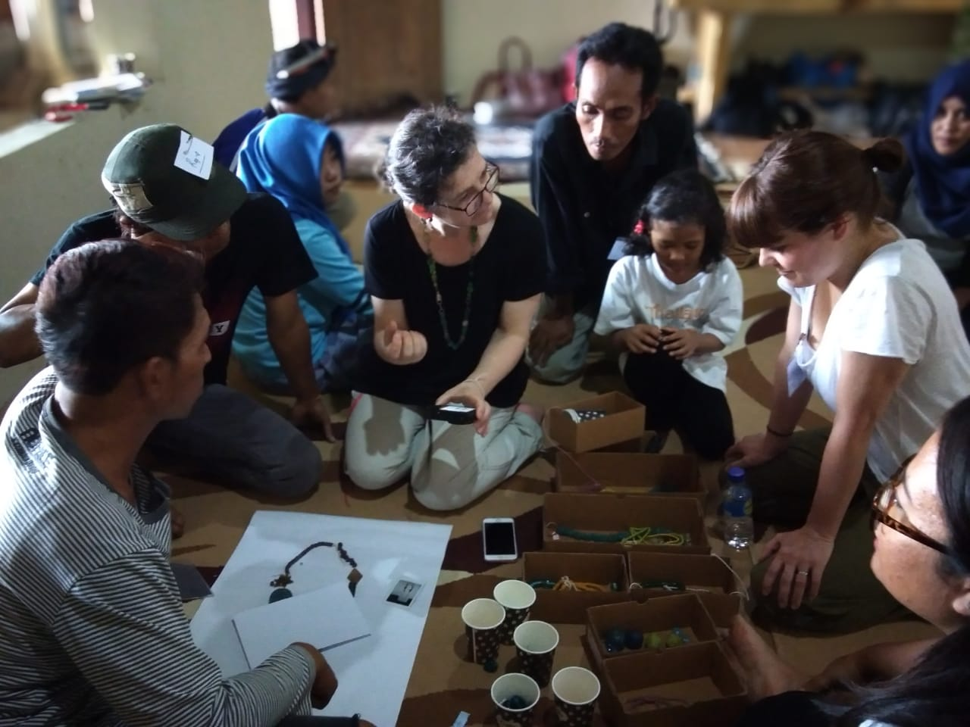
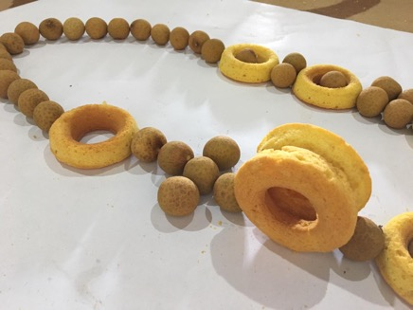
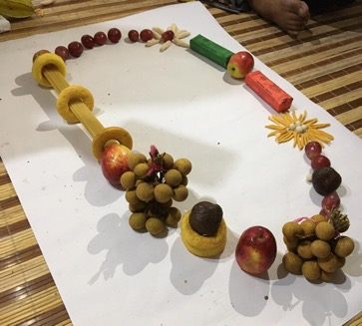
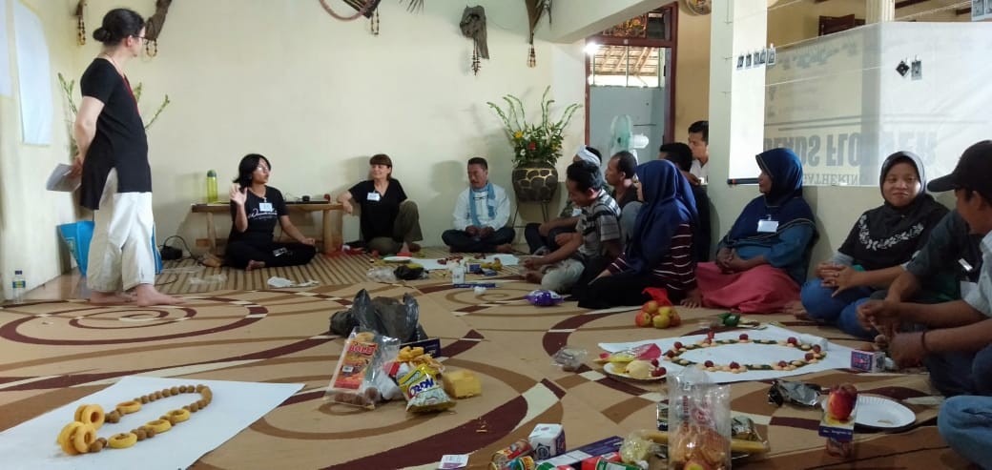
Notes:
Vero/Maria/Laura
In 2019 the Making Links field work had two distinct phases
1.Focused research that analysed current craft products being made in Jombang, in order to better understand creative opportunities.
2. Planning and delivery of a short intensive co-creative design thinking and making workshop in Jombang with 17 artisans, in order to develop new prototype craft products for the export market.
(25 seconds)

Slide 17
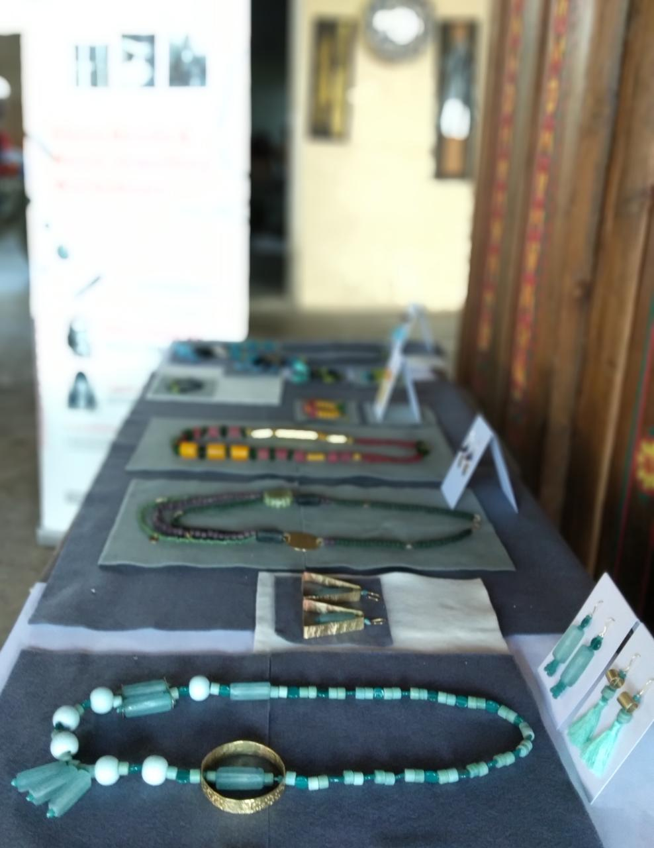
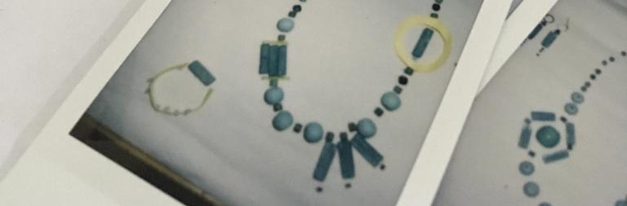
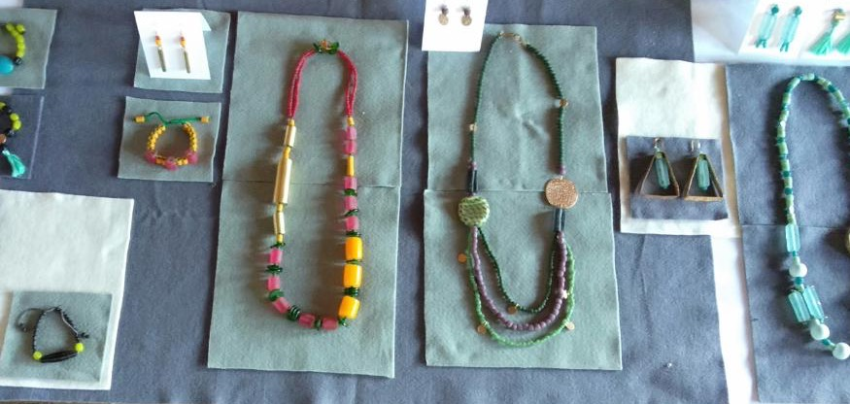
Notes:
Vero/Maria/Laura
The structure, content and underpinning methodologies of the workshop enabled the craftspeople to produce their own knowledge, and discover their own potential and strengths. The use of local food products as design inspiration was a provocative way to encourage design thinking by situating within their daily lives.
As the workshop involved craftspeople from various backgrounds and making skills, they generously shared knowledge through collaborative making, which strengthened confidence, and resulted in the production of 4 new prototype jewellery design collections.
(35 seconds)

Slide 18
Crafting Creativity and Collaboration in 2020-2021
Notes:
Laura
When the world was catapulted into the Global pandemic, momentarily bringing everything to a halt, the team had to make an adaptive response. The situation imposed by the pandemic, where we were forced to stay at home, required a new approach to ways of working and the team began experimenting with virtual design thinking workshops.
The idea of creating and planning virtual workshops was possible because all team members have the privileges of prior knowledge, experience, and access to digital platforms.
However during planning and subsequent testing we were mindful in acknowledging that potential participants would not have the same knowledge, skills and resources and worked through ways that we could facilitate this.
(45 seconds)

Slide 19
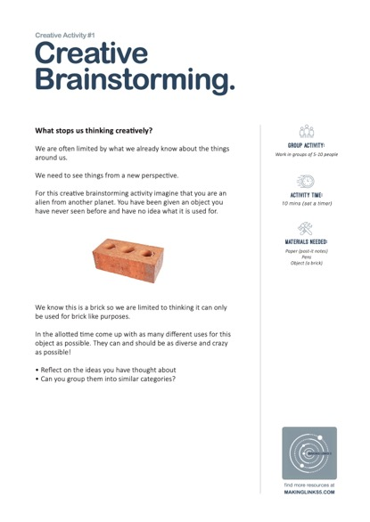
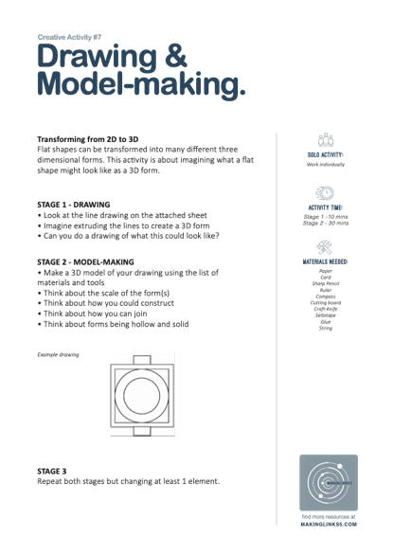
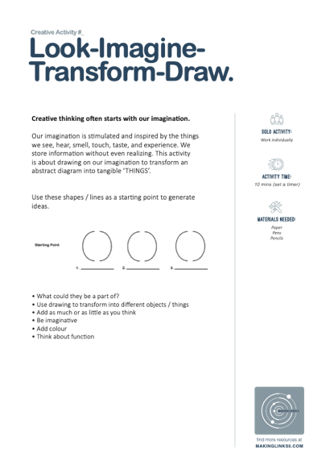
Toolkit Development and Testing
Notes:
Vero/Maria/Laura
During the 2019 post-workshop discussion the team talked about their ambition to create a sustainable model and whether a strategy could be developed for workshop facilitators to train others, who would then train others to create a snowball effect. We envisaged being able to build capacity and give greater representation and power to those who would both participate and facilitate in future initiatives. Early in 2020, initial development of resources and toolkits began, which we had hoped to use within the physical contexts identified.
(35 seconds)

Slide 20
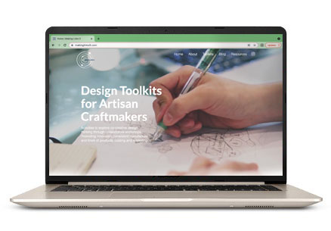
Notes:
Vero/Maria/Laura
A multi-function website (which is still a work in progress) was created to facilitate the sharing of co-creative work, acting as an exhibition space, a place to document research, and ultimately to be used as a learning platform to access design toolkits and resources.
(20 seconds)

Slide 21

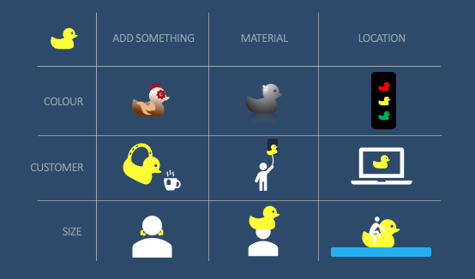
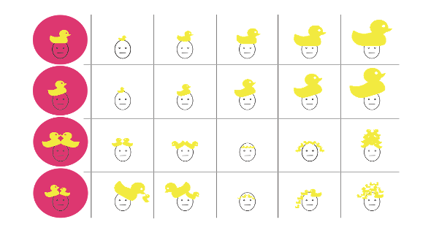

Stage 1
Stage 2
Stage 3
Notes:
Laura
In 2020 Before the virtual design thinking workshop was conducted and launched with a wider audience, the team held several trials. The main objectives were to test content and structure of the toolkits, time scale and flow, clarity of presentation and the digital technology.
Testing provided the opportunity to make improvements and facilitated the training of the first workshop trainers. The first trial (for example) highlighted the need to make a workshop schedule that listed each stage of the activity.
(30 seconds)

Slide 22


Notes:
Laura
ZOOM was used as the virtual platform. And in the first trials the interactive elements were facilitated with the simple minds and google Jamboard mapping tools, both of which had their problems.
When working in the field it is crucial to prepare and structure content, however it is also important to be agile during the workshop and to respond appropriately, making changes and adjustments to the flow and content if the situation and response of participants require. Within the virtual workshop landscape, being agile in the moment is much more difficult to achieve
(35 seconds)

Slide 23
Online Workshop Activities 2021
Notes:
Laura
The workshop content was tested with 3 different groups during 2020 and during the following months we were able to refine and adapt based on the context and participant numbers for the workshops being planned for 2021.
(15 seconds)

Slide 24

Notes:
Vero/Maria/Laura
The starting point for the development of toolkits and resources began with an analysis of the physical workshop activities in Jombang, in 2019. By deconstructing these we were able to identify and classify component parts of the ‘Design’ process and explore creative activities that would be understandable within the artisan communities we were ultimately trying to reach.
Design is a process that needs practice, but does not have a singular, linear or finite set of rules. It requires idea generation, research, making prototypes/samples, problem-solving, testing materials, and final production.
In the series of virtual workshops discussed in our paper the activities devised and delivered are illustrated here.
(45 seconds)

Slide 25


Notes:
Vero/Maria/Laura
The first workshop in 2021, was delivered by ITS and facilitated by participants trained during 2020. There were 45 participants (12 times greater than previous events)
Although a challenge, it allowed the team to test accelerating the online strategy for greater capacity building. Having more people resulted in less opportunity for verbal discussion and therefore additional digital tools were introduced.
As this event was delivered more than a year after the pandemic had begun, new interactive tools had been tested and the team had greater experience in using breakout rooms in video conferencing software. To ensure that every participant had the opportunity to share ideas, we introduced the MIRO interactive whiteboard application.
(50 seconds)

Slide 26





Notes:
Vero
as MIRO interactive whiteboard application was used so everyone could see each other’s ideas visually, from participants’ work we observe that the sessions allowed them to confidently express their opinions and present unique ideas without worrying about being criticized.
The circle activity enabled the participants to think and generate ideas in a short time where the images created reflected familiar daily objects seen by the participants.
Initial ideas generated for the mood board activity were based on the interesting things they liked. However, the facilitator reiterated the importance of visual research to observe detailed qualities in form, colour and texture. This enabled participants to choose images not just based on what they liked but in response to other criteria.
(50 seconds)

Slide 27




Notes:
Vero
With 12 rural crafts makers we're delivering a three-day hybrid workshop to help them realize and discover their creative potential. The crafts makers learned how to generate ideas and create a visual mood board. They used their imagination to create a variety of unique design ideas inspired by their daily lives.
(25 seconds)

Slide 28




Notes:
Laura
As part of the ongoing development of the training materials we adapted and delivered a series of 5 workshops via zoom to trainers based in Salinas de Guaranda, in the mountains of Ecuador. They went on to run these workshops with 3 rural indigenous communities of women making craft products. Having never done production work before, much of the training has focused on other factors that impact on the design process such as material costs and making time.
(20 seconds)

Slide 29








Notes:
Laura
Fair trade is about long term relationships based on solidarity, trust and mutual respect. One of the key goals of the initial project in 2019 was that the jewellery that we collectively developed would become the basis of a product range that could be brought to market. As a result of this continued collaboration, these 4 collections have been refined and expanded. Just Trade are showcasing these at an International trade show in London this month. We already have interest from independent retailers and prominent museum gift shops and are therefore hopeful that this is the start of a successful long term trading partnership.
(30 seconds)

Slide 30





Key Findings
Participants’ Contexts
Time
Scale
Online Infrastructure
The Facilitators
The
Toolkits
Notes:
Vero
Through the journey of our online workshop by this far, some key findings in this research are as follows :
Participants’ Contexts
To create a democratic learning environment, it is important to acknowledge participants’ local context (geographical, economic, political, social, and cultural).
Time Scale
As people involved in this workshop are in different time areas having different schedules, participating in this workshop requires considerable commitment. Timekeeping is vital so that the workshops run efficiently and to planned schedules.
Online Workshop Infrastructure
To make the workshop run optimally, virtual learning must be supported by supporting devices and infrastructure such as software (applications that facilitate teleconferences like ZOOM, Google meet, or Whatsapp) and hardware (cell phone, computer, webcams, microphones, and internet networks)
Facilitator
Facilitators play a vital role in the workshop where they have to be aware of participants’ contexts, create an inclusive ambience with more equal power dynamics, and also give appreciation and constructive criticism.
Toolkits
The toolkits must be contextual and flexible to be adjusted so that it can stimulate participants’ creative potential. It has to be easy to understand and accommodate participants with diverse backgrounds and experiences.
(85 seconds)

Slide 31

Thank you for listening
Further Reading :
https://www.makinglinks5.com/resources
Authors’ Email :
veronicaajeng@gmail.com
m.hanson@shu.ac.uk
laura@justtrade.co.uk
e_zulaikha@prodes.its.ac.id
Notes:
Vero
Thank you for listening. We can continue discussing this later in the Questions & Answer session, if you want more information or further reading you can go to our website, makinglinks5.com, or if you need another inquiry you can contact us through our email below. Thank you.
15 seconds

