Slide 1
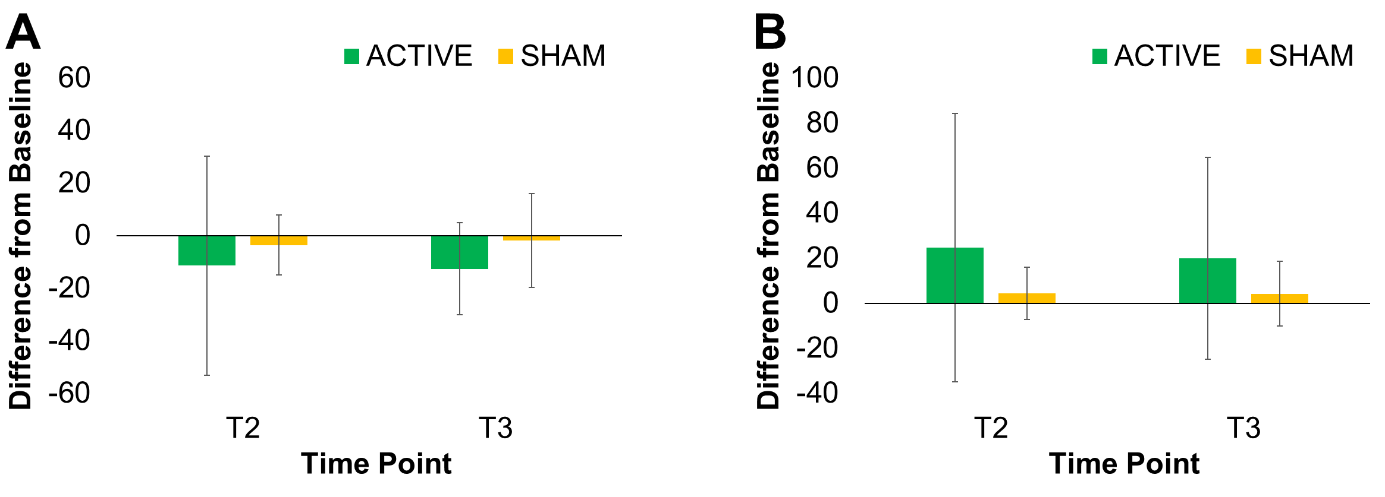
Appeal biases for sweet and fatty foods are robust following a single session of transcranial direct current stimulation (tDCS) in a healthy population.
Jordan D. Beaumont¹*, Danielle Davis¹, Michelle Dalton¹, Mark Russell¹, and Martin J. Barwood¹
¹School of Social and Health Sciences, Leeds Trinity University, Horsforth, UK
* j.beaumont@leedstrinity.ac.uk @JordanDBeaumont
Introduction
1
Hypo-activation of the dorsolateral prefrontal cortex (DLPFC) is associated with increased reward response to high-calorie foods¹. tDCS over the DLPFC has been shown to reduce food cravings and consumption, attenuating this reward response². Eating behaviour traits, such as binge-eating, are associated with abnormal activity in the prefrontal cortex (PFC)³. These traits may be relevant to tDCS outcomes, yet they have not been assessed following tDCS in a healthy population.
What is tDCS?⁴
A form of non-invasive brain stimulation where a weak electrical current is passed between electrodes (anode and cathode) placed on the scalp.
Anode (anodal “excitatory” tDCS)
Increases activity by inhibiting the activity of gamma-aminobutyric acid (GABA), increasing the likelihood of spontaneous cell firing.
Cathode (cathodal “inhibitory” tDCS)
Decreases activity by inhibiting the activity of glutamate, decreasing the likelihood of spontaneous cell firing.
Accordingly, the present study develops our understanding of the role tDCS plays in appetite control, assessing the effects of stimulation on food reward and craving in healthy-weight participants. We hypothesise that anodal tDCS of the right DLPFC will reduce in-the-moment food craving and the preference for sweet and high-fat foods.
Method
2
Double-blind, sham-controlled, within-participant design.
N = 21 (11 female, 24±7 years, 22.8±2.3 kg·m⁻²)
Eating behaviour traits were measured at baseline using the Food Craving Questionnaire-Trait (FCQ-T-r)⁵, Control of Eating Questionnaire (CoEQ)⁶, and Three Factor Eating Questionnaire (TFEQ-r18)⁷.
tDCS Parameters: Anodal “excitatory” tDCS was delivered at 2 milliampere (mA) for 20 minutes (ACTIVE) or 36 seconds (SHAM*). The anode was placed over the right DLPFC, and the cathode was placed over the occipital lobe.
*Blinding protocol that has limited neuromodulatory effect, but elicits similar sensations compared with ACTIVE tDCS¹²
Data Analysis: Test-retest reliability of baseline data were determined using Pearson's correlations. Data were compared using analysis of variance (ANOVA) to an alpha level of 0.05.
Session Timeline
2x tDCS sessions scheduled between 09:00 and 15:00, following a 4-hour fast
(randomised and counterbalanced, 48-hour minimum washout period).
0 min
20 min
50 min
70 min
90 min
T1
Questionnaires
tDCS
T2
Questionnaires
Interval
T3
Questionnaires
Questionnaires:
Appetite visual analogue scales⁸; 100mm scales measuring hunger, fullness, prospective consumption and the desire to eat.
Leeds Food Preference Questionnaire (LFPQ)⁹; computer-based task measuring implicit liking and wanting, and explicit wanting for foods.
Food Craving Questionnaire-State¹⁰; 15-item questionnaire measuring momentary food craving over a 5-point Likert scale.
Results
3
Test-retest analysis indicated moderate-to-good reliability of baseline measures highlighting good correlation (r=0.536-0.955, p<0.02), except for the desire to eat which was poorly related (r=0.382).
Food Craving and Appetite
tDCS had no significant effect on food craving (p=0.896), or ratings of hunger (p=0.515), fullness (p=0.734), prospective consumption (p=0.415) or desire to eat (p=0.141).
Implicit Wanting Appeal Bias
tDCS did not significantly change taste (p=0.704) or fat appeal biases (p=0.502) (Figure 1). There were no differences in explicit liking or wanting measures of the LFPQ.
Eating Behaviour Traits
Participants displayed a healthy eating behaviour trait profile (Table 1).
Table 1: Participants’ eating behaviour trait profile.
FCQ-T-r⁵ |  | 35±9
CoEQ⁶ | Craving Control | 67±18
 | Craving for Sweet Foods | 29±18
 | Craving for Savoury Foods | 51±23
TFEQ-r18⁷ | Cognitive Restraint | 40±20
 | Uncontrolled Eating | 33±14
 | Emotional Eating | 22±22
Figure 1: Absolute difference from baseline scores for implicit wanting.
(A) Taste and (B) fat implicit wanting appeal bias. Scores are calculated using a frequency-weighted algorithm, and typically range from -100 to 100. A score >0 highlights a bias towards sweet/high-fat foods, and a score <0 highlights a bias towards savoury/low-fat foods.
Mean ± SD scores. Possible scores range from 15-90 for the FCQ-T-r, and 0-100 for the CoEQ and TFEQ-r18.
Conclusion
4
Healthy participants with no apparent eating behaviour trait susceptibilities to overconsume did not respond to stimulation, suggesting increasing DLPFC activity using tDCS does not change food reward response in healthy controls. However, unhealthy groups remain a plausible target for tDCS intervention.
Future Direction: Examine the effects of tDCS on appeal bias in individuals with “problematic” eating behaviour traits (e.g. high trait craving or binge-eating) who are overweight/obese or at risk of weight gain.
¹ Alonso-Alonso & Pascual-Leone (2007) Front Hum Neurosci 7, 512; ² Hall & Lowe (2018) Nutr Neurosci, 1-4; ³ Boeka & Lokken (2011) Eat Weight Disord 16, e121-126; ⁴ Filmer et al. (2014) Trends Neurosci 37, 742-753 ; ⁵ Meule, Hermann & Kübler (2014) Front Psychol 5, 190; ⁶ Dalton, Finlayson & Blundell (2015) Eur J Clin Nutr 69, 1313-1317; ⁷ de Lauzon et al. (2004) J Nutr 134, 2372-2380; ⁸ Dalton, Blundell & Finlayson (2013) Obesity Facts 6, 348-359; ⁹ Dalton & Finlayson (2014) Physiol Behav 136, 128-134; ¹⁰ Capeda-Benito et al. (2000) Behav Ther 31, 151-173; ¹¹ Steptoe, Pollard & Wardle (1995) Appetite 25, 267-284; ¹² Brunoni et al. (2011) Int J Neuropsychop 14, 1133-1145
School of Social and Health Sciences
Leeds Trinity University, Horsforth, UK
UK Congress on Obesity
September 2019, University of Leeds

