Slide 1
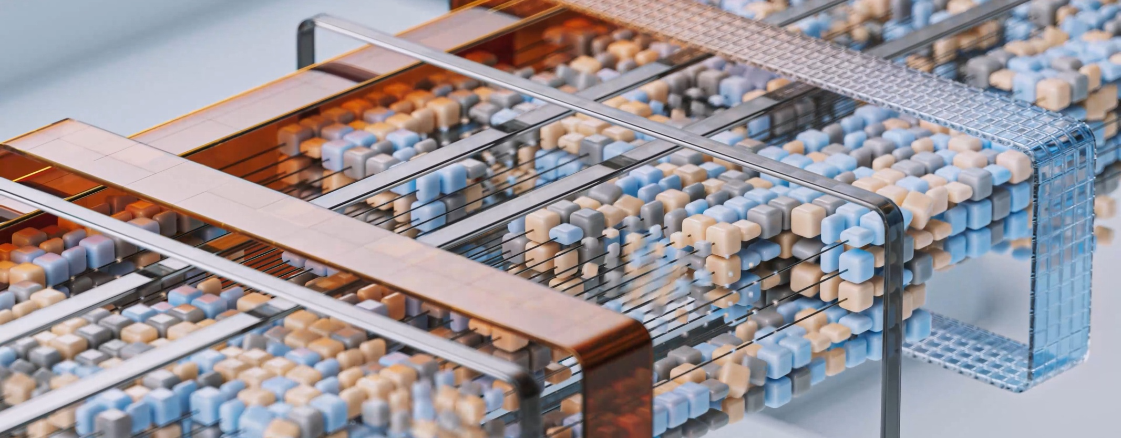
"There's an AI for that!"
Introduction to different ways generative AI can be used in higher education
Notes:
Play HeyGen Welcome video.

Slide 2
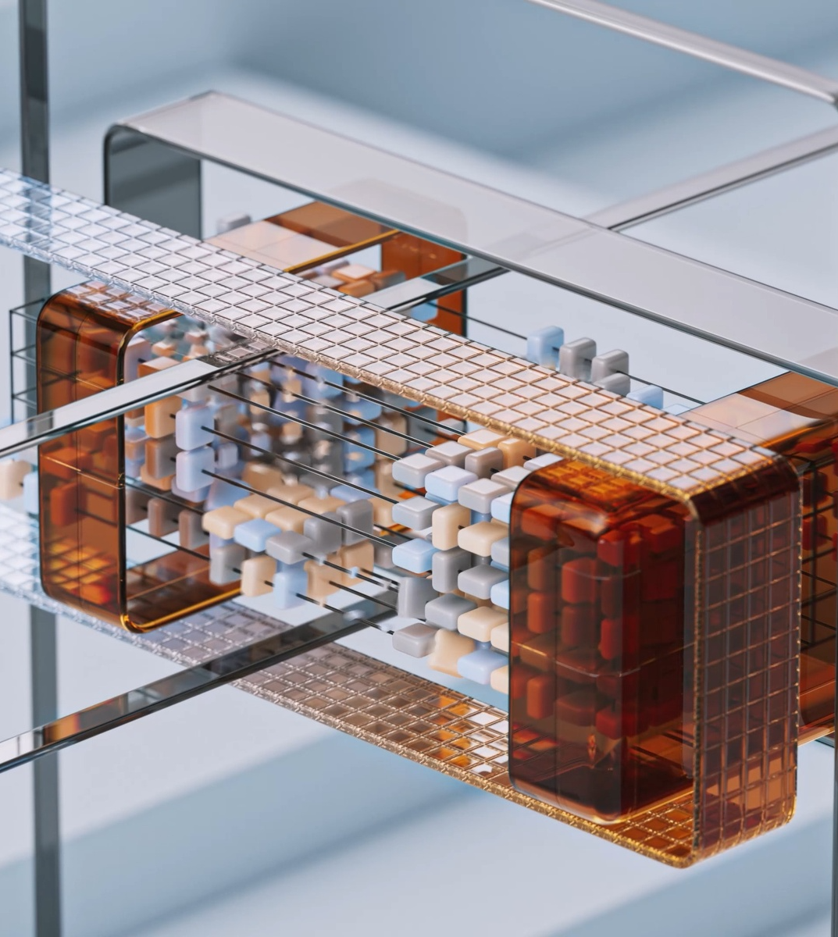
Introduction to Generative AI
Generative AI refers to artificial intelligence models and systems that can generate new content like text, images, audio, and video. It involves training machine learning models on large datasets so they can learn patterns and produce novel, realistic outputs. Some common examples of generative AI include natural language processing models that generate text, GANs and diffusion models that create images, and systems that generate music or human voices.
Notes:
I am not going to go into any definitions in depth but just as an overview, AI is an umbrella term and the area we are looking at today is generative AI, this refers to AI models and systems that can generate new content from the large datasets that it has been trained on. Large language models and natural language models produce text, Generative adversarial networks and diffusion models for images and systems that generate music or human voices.Setting the scene in terms of how fast generative AI has come and why it is important that we as educators maintain our role as the leaders and educators of our students. Preparing them for a digital world involves not only providing opportunities to learn their core subjects but also become familiar with the tools that will assist in their learning and enabling them to emerge prepared and equipped for a digital world. Bill Gates= 2 technologies seen as revolutionary- first graphic user interface- eventually becoming Windows and second in 2016 when he first met with Open AI – in 2022 he set a challenge – train an artificial intelligence to pass an Advanced Placement biology exam. Make it capable of answering questions that it hasn’t been specifically trained for. What he thought would take years turned out to be mere months when GPT was introduced.

Slide 3
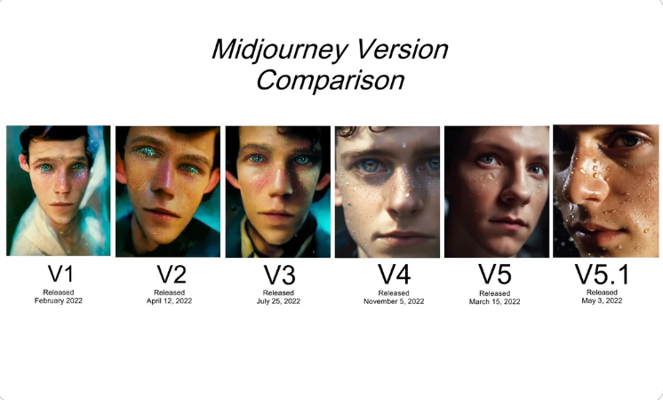
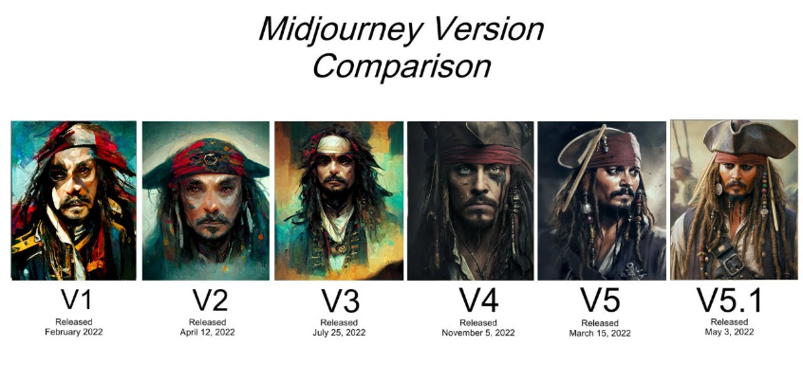
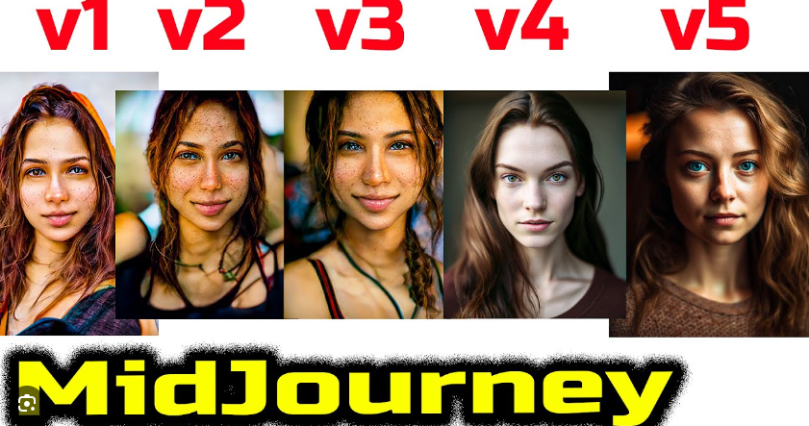
MIDJOURNEY EVOLUTION 2022 - 2023
Start
End
Notes:
Setting the scene in terms of how fast generative AI has comeMidjourney is text to image GenAI- this is one that has been trained on human faces and as you can see in just over a year it has become very close in generating images that are difficult to tell whether it is "real" or AI generated. IN May 2023 Amnesty International were criticised for using an AI generated image of "human rights abuses" in Colombia sparking further debate around how can you tell what it real
IN April 2023 photo “The Electrician” wins world renowed photography competition- generated using DALLE- 2

Slide 4
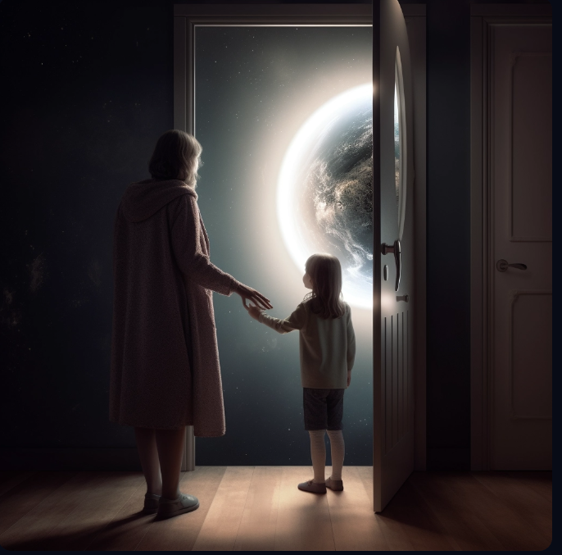
Midjourney
Your clinical placement is the bridge between your textbooks and real-life nursing. Cross it with courage, knowledge, and a lot of heart.
Notes:
Examples of how I have used Midjourney

Slide 5
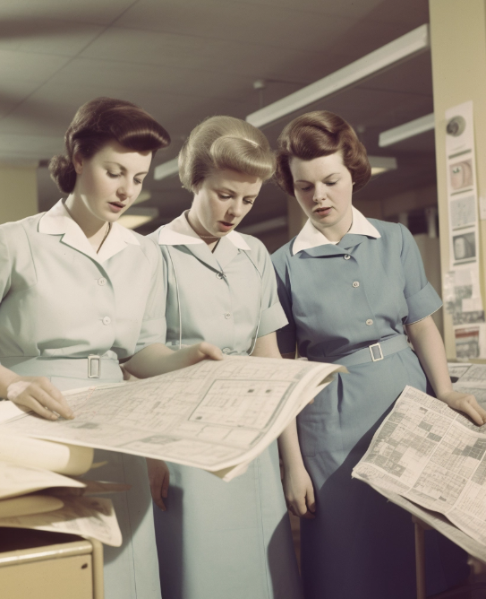
AI Images from Midjourney
1950'S
1960'S
1990'S
Notes:
Until fairly recently for most nurses and midwives data collection would mean completing patient notes, creating care plans and these for a large proportion of time have been stored in paper based folders. As you can see, the uniforms may have changed over the decades but our means of collecting data has not altered that significantly. As we move towards the future, Nursing and Midwifery education has evolved and adapted with significant changes being made from the 1990's to the eventual degree only route for professional registration into both of these professions. These changes influenced the curriculum offered and called for a redesign and change in the content, however the need to include healthcare analytics or digital skills was still not a priority or seen as a need to be included prior to qualification and was rather seen as something that would be considered within specialist roles with post registration qualifications managing the content and delivery. Remind everyone that these images are not real- these people do not exist and if the same prompt were used again then different images would be generated

Slide 6
HEYGEN VIDEO AVATARS
Play via YouTube
Notes:
Most people will no doubt be familiar with ChatGPT or other LLM's that produce text, one of the areas that I particularly have been interested in using is the additional addons or plugins that can provide further variation. One example of that is creating video avatars. Combine a text prompt on Chatgpt and ask it to use in this case HeyGen and it converts the text into a video. The person speaking is an AI avatar.

Slide 7
CHATGPT 3/4 plus PLUGINS
Notes:
SummariseBlendedStructured Concepts and questioning depending upon audience- age range/ profession etcBrainstorming and providing initial ideas or key points that could be considered within workPersonalised Learning- SPeech therapy example

Slide 8
Applications in Course Content Creation
Co-Creation Lecture Material Generation
Co Creation Assignment Generation
Co- Creation Simulation Scenarios
Use natural language generation models to automatically create lecture slides, notes and transcripts from a topic outline. A mixture of voice clone software, AI avatars, research notes have been used and combined to produce materials in a variety of formats
Use natural language generation and task-specific models to automatically generate quiz questions, problem sets and assignments for a course module.
Use generative models to automatically generate lab manual content including procedures, analysis questions and report templates for lab assignments.
Co-creation Summary Generation
Personalized Content Generation
Feedback Generation
Use summarization models to automatically generate summaries of textbook chapters, research papers and other course materials for students. Currently developed this with own materials to provide summaries and develop post session content.
Use student profiles and learning analytics to automatically generate personalized content, assignments and recommendations for each student.
Use natural language models for students to set own questions and provide feedback to answers- learning to reword/ rephrase responses for given audiences to provide audiences.
Notes:
The emphasise is on the co-creation. To rely on a tool whichever that maybe introduces the possibility of loosing skills- spelling/grammar and punctuation are classic examples of this when we only use spell check etc. Auto tab on your emails on google or on your phone, and this is no different.However it can be useful in terms of co- creation and these are some areas that I have used it on a small scale. For each of these areas, I have used my own materials so the original content has not been created by AI, but then AI tools have been used to provide different versions/ formats of materials for lecturer notes. Summary tools used where video content or podcasts have been made available to support materials or for D/L modules to support learning and to ensure that key points are recapped. Quizzes and short/ long answer questions generated- one advantage is these will change each time you ask the same prompt, a different variation is generated.

Slide 9
Efficiency Increase in Literature Review
Improved Insights from Text Analysis
Research and Discovery
Faster Hypothesis Generation
More Targeted Experiment Design

Slide 10
AI Research Tools
Research Rabbit
Elicit AI
Scite AI

Slide 11
Chatbots and Virtual Assistants
Chatbots and virtual assistants are AI systems that can understand natural language questions from students and provide helpful information or guidance in response. These systems leverage natural language processing and machine learning to have increasingly natural conversations that assist with common student questions and needs.
Notes:
BraniaSUpport and inclusivity

Slide 12
Other Possibilities- Personalized Recommendations
Tailored Course Recommendations
Personalized Activity Recommendations
Adaptive Learning Paths
Suggest courses and learning materials based on the student's interests, academic performance, and career goals.
Recommend extracurricular activities like research projects, competitions, and mentoring opportunities matched to each student's strengths and aspirations.
Dynamically adjust the sequence of courses, materials, and activities for each student to optimize their learning and development.
Relevant Resource Recommendations
Mentor Matching
Suggest specific learning resources like online materials, textbooks, and academic papers tailored to each student's current coursework and knowledge gaps.
Connect students to faculty, alumni, industry experts, and peers who can provide personalized mentoring and advice.

Slide 13
Challenges- Plagiarism Detection- current method
Collect student work
Upload work to plagiarism checker
Review plagiarism report
Take action on plagiarism
Gather student assignments, essays, reports, etc. to check for plagiarism.
Use an automated plagiarism detection tool to upload the student work.
The tool will scan the work and provide a report highlighting any unoriginal or improperly cited content.
If plagiarism is found, follow institutional policies .
Notes:
It can beat plagiarism detection toolsAI Hallucinations- based on probability and predicting the next word/ phrase/sentence or paragraph- but not able to assess or recognise the truth or accuracy of the responses- (In MAy 2023 New York lawyer of 30 years used it to find similar cases in attempt to prove precedence and cited several cases that were made up! case in America- cited cases that were not real!)It's only as good as the dataset it was trained on- 2016 Microsoft Tay- trained on social media- made offensive remarks and was withdrawn
Ethical framework- bias and offensive remark reductions built in
Debate- pro's/ con's of using
Max Tegmark and Lex Fridman podcasts

Slide 14
The future of higher education is not just about adapting to change, but leading it. Generative AI challenges us to rethink the very nature of teaching and learning, pushing us beyond traditional boundaries. As we integrate this technology, we're not only reshaping our educational landscape to be more responsive and adaptive, but we're also setting the foundation for the classrooms of tomorrow. Let's harness the power of generative AI to create a more dynamic, personalised, and innovative learning environment for all, ensuring we make decisions today that inspire and elevate the learners of tomorrow.
Notes:
Close and any questionsDiscord site

