Slide 1
Compassion in Healthcare Practice
Dr Carmel Bond PhD
Lecturer in Mental Health Nursing
Sheffield Hallam University

Slide 2
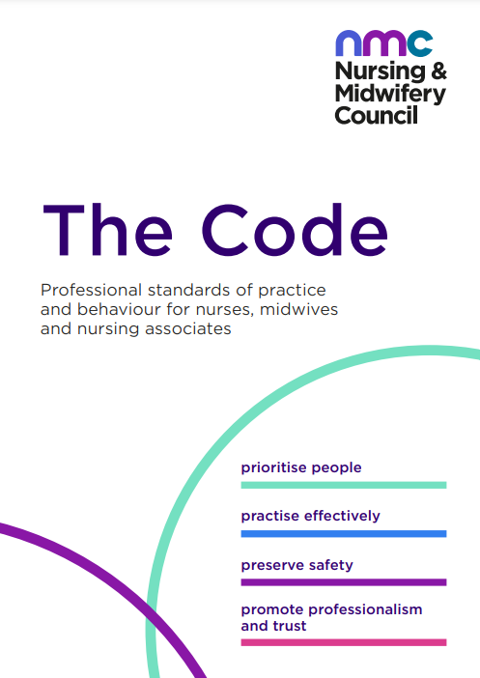
Compassion is a Core Value

Slide 3
What is Compassion?

Slide 4
How is Compassion Defined?
Compassion is identified as a ‘inherently human quality’ whereby a healthcare professional seeks to understand and respond to the suffering of another human being (Sinclair et al., 2016)

Slide 5
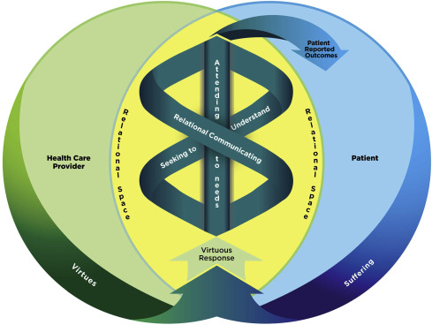
A Model of Compassion
(Sinclair et al., 2016)

Slide 6
Evidence for Compassion in Healthcare
Participants & (n=) #of papers | Focus | Findings
Patients (n =12) | Conceptualisations of compassion - reflecting on personal experiences with their HCPs | Kindness, authenticity, attentiveness, forming a relational connection, displaying presence and warmth, acceptance, understanding, listening, helping, communicating effectively, being involved, and being gentle and caring
HCPs (n =18) | Conceptualisations of compassion & compassionate behaviours | An inner desire to want to relieve one’s suffering. Response based on sensitivity to patients’ preferences. ‘Professional Compassion’ – good communicator; element of ‘tough love’
Patients & HCP (n=60) | Conceptualisations of compassion | ‘A predisposition’; part of one’s personality; linked with religion & spirituality. Motivated by personal experiences of suffering, having had to provide care to ill family members etc.
 | Challenges & enablers | HCP - Learn through role modelling/socialisation; time, resources, organisation aspects, presentations of patient, managerial, fragmented teams Patients – more education needed! Experiential learning and support from managers
Malenfant et al (2022) Compassion in healthcare: an updated scoping review of the literature. BMC Palliat Care 21, 80.

Slide 7
Patient Reported Outcomes
Compassion...
Alleviates suffering
Enhances overall well-being
Improves perceived quality of care received from HCPs
Allays distress
Enhances patients’ relationship with their HCPs
Malenfant et al. (2022) Compassion in healthcare: an updated scoping review of the literature. BMC Palliat Care 21, 80.

Slide 8
How might compassion be experienced in the context of giving and receiving mental health care?

Slide 9
In the Context of Mental Health....Compassion is a Verb!
Seeking to understand the person beyond the diagnosis
Having the forethought to prevent suffering in the future
Human Connection
HCP-Patient
Therapeutic Relationship
Prescence & warmth of the HCP
Bond, C., Hui, A., Timmons, S., Wildbore, E., & Sinclair, S. (2022). Discourses of compassion from the margins of health care: the perspectives and experiences of people with a mental health condition. Journal of Mental Health, 1-9.

Slide 10
Healthcare Work is Challenging
1. Capacity to tolerate the suffering of other (vicarious trauma from caring)
2. Reduced resources and austerity measures
3. Increasing demands and demand for healthcare
(Murray et al., 2020)

Slide 11
Practice Self-Compassion (See Abdollahi et al., 2021)
www.self-compassion.org

Slide 12
What’s in Your Self-Compassion Kitbag?
Meditation
Hobbies
Smells
Soothing objects
Music/ song lyrics
Favourite tastes - cooking
Poetry
Mindfulness – settling
Notes:
12

Slide 13
Sheffield Hallam University Compassionate Practice Group

Slide 14
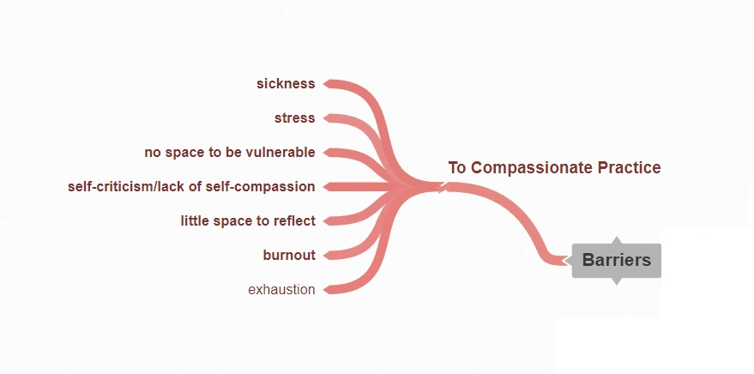

Slide 16
We have created a space where we can be vulnerable together and support one another. A space where we can reflect together and challenge the status quo.

Slide 17
Thank you!
Dr Carmel Bond
C.Bond1@shu.ac.uk
@Bond_Carmel007
Rosie Carter-Rich
rosie.carter-rich@student.shu.ac.uk

Slide 18
References
Abdollahi, A., Taheri, A., & Allen, K. A. (2021). Perceived stress, self-compassion and job burnout in nurses: the moderating role of self-compassion. Journal of Research in Nursing, 26(3), 182-191.
Bond, C., Hui, A., Timmons, S., Wildbore, E., & Sinclair, S. (2022). Discourses of compassion from the margins of health care: the perspectives and experiences of people with a mental health condition. Journal of Mental Health, 1-9.
Chaney, S. (2021). Before compassion: sympathy, tact and the history of the ideal nurse. Medical Humanities, 47(4), 475-484.
Malenfant, S., Jaggi, P., Hayden, K.A. et al. (2022). Compassion in healthcare: an updated scoping review of the literature. BMC Palliat Care 21, 80. https://doi.org/10.1186/s12904-022-00942-3
Murray, C. J. L., Abbafati, C., Abbas, K. M., Abbasi, M., AbbasiKangevari, M., Abd-Allah, F., Abdollahi, M., Abedi, P., Abedi, A., Abolhassani, H., Aboyans, V., Abreu, L. G., Abrigo, M. R. M., AbuGharbieh, E., Abu Haimed, A. K., Abushouk, A. I., Acebedo, A., Ackerman, I. N., Adabi, M., … Lim, S. S. (2020). Five insights from the global burden of disease study 2019. The Lancet, 396(10258), 1135–1159.
Sinclair, S., McClement, S., Raffin-Bouchal, S., Hack, T. F., Hagen, N. A., McConnell, S., & Chochinov, H. M. (2016). Compassion in health care: an empirical model. Journal of pain and symptom management, 51(2), 193-203.
Notes:
18
18

