Slide 1
compassion in nursing
Dr Carmel bond (she/her)
Lecturer in Mental Health Nursing
Sheffield Hallam University

Slide 2
Imagine

Slide 3
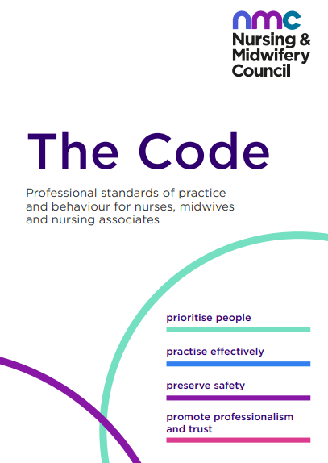
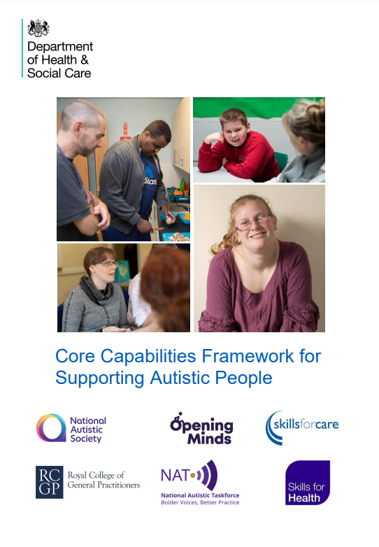
Compassion is ubiquitous

Slide 4
Compassion has always been associated with nursing, hasn’t it?
2009
Turing Point Changes to discursive constructions of compassion
Ethical or Moral Character of the Nurse
Compassion linked to nurses’ individual behaviours and attributes
Sympathy
Empathy
Development of Compassion Research
Tact
NMC Code (2008) – no mention of compassion
NMC Code (2018) revised to include compassion
1918
2020
Chaney, S. (2021). Before compassion: sympathy, tact and the history of the ideal nurse. Medical Humanities, 47(4), 475-484.

Slide 5
What is compassion really?
When you think about compassion, what comes to mind?

Slide 6
How is Compassion Defined?
An inherently human quality whereby the healthcare professional seeks to understand and respond to the suffering of another human being (Sinclair et al., 2016)

Slide 7
What might this look like in practice?
Recognition of suffering
Virtuous Response

Slide 8
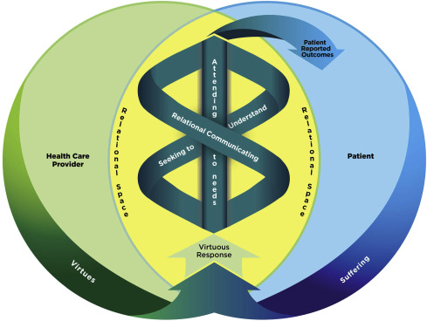
a model of compassion
Sinclair et al., 2016

Slide 9
What does human suffering look like?
Notes:
In the context of healthcare, what does human ‘suffering’ look like?

Slide 10
How might compassion be experienced in the context of mental health care?

Slide 11
Communicating Compassion in Mental Health Nursing
Warm
Calm Manner
Seeks to Understand the Person
Presence
Non-Judgemental Approach
Beyond Diagnosis
Trauma-informed
Engagement
Active Listening
Validation
Clinical Skills
Bond, C., Hui, A., Timmons, S., Wildbore, E., & Sinclair, S. (2022). Discourses of compassion from the margins of health care: the perspectives and experiences of people with a mental health condition. Journal of Mental Health, 1-9.
Notes:
11

Slide 12
In the Context of Mental Health....Compassion is a Verb!
Seeking to understand the person beyond the diagnosis
Having the forethought to prevent suffering in the future
Human Connection
HCP-Patient
Therapeutic Relationship
Presence & warmth of the HCP
Bond, C., Hui, A., Timmons, S., Wildbore, E., & Sinclair, S. (2022). Discourses of compassion from the margins of health care: the perspectives and experiences of people with a mental health condition. Journal of Mental Health, 1-9.

Slide 13
Why is compassion so important?
Patients report that compassion...
Alleviates suffering
Enhances overall well-being
Improves perceived quality of care received from HCPs
Allays distress
Enhances the relationship with their HCPs
Malenfant et al. (2022) Compassion in healthcare: an updated scoping review of the literature. BMC Palliat Care 21, 80.

Slide 14
Healthcare Work is Challenging
1. Capacity to tolerate the suffering of other (vicarious trauma from caring)
2. Reduced resources and austerity measures
3. Increasing demands and demand for healthcare
(Murray et al., 2020)

Slide 15
Practice Self-Compassion (See Abdollahi et al., 2021)
www.self-compassion.org

Slide 16
What’s in Your Self-Compassion Kitbag?
Favourite tastes - cooking
Meditation
Smells
Music/Song lyrics
Soothing objects
Poetry
Hobbies
Mindfulness – settling
Walking/Nature
Notes:
16

Slide 17
Thank you!
Dr Carmel Bond
C.Bond1@shu.ac.uk
@Bond_Carmel007
ESRC-funded PhD: Completed 2023
Supervised by Professor Stephen Timmons and Dr Ada Hui (University of Nottingham)

Slide 18
References
Abdollahi, A., Taheri, A., & Allen, K. A. (2021). Perceived stress, self-compassion and job burnout in nurses: the moderating role of self-compassion. Journal of Research in Nursing, 26(3), 182-191.
Bond, C., Hui, A., Timmons, S., Wildbore, E., & Sinclair, S. (2022). Discourses of compassion from the margins of health care: the perspectives and experiences of people with a mental health condition. Journal of Mental Health, 1-9.
Chaney, S. (2021). Before compassion: sympathy, tact and the history of the ideal nurse. Medical Humanities, 47(4), 475-484.
Malenfant, S., Jaggi, P., Hayden, K.A. et al. (2022). Compassion in healthcare: an updated scoping review of the literature. BMC Palliat Care 21, 80. https://doi.org/10.1186/s12904-022-00942-3
Murray, C. J. L., Abbafati, C., Abbas, K. M., Abbasi, M., AbbasiKangevari, M., Abd-Allah, F., Abdollahi, M., Abedi, P., Abedi, A., Abolhassani, H., Aboyans, V., Abreu, L. G., Abrigo, M. R. M., AbuGharbieh, E., Abu Haimed, A. K., Abushouk, A. I., Acebedo, A., Ackerman, I. N., Adabi, M., … Lim, S. S. (2020). Five insights from the global burden of disease study 2019. The Lancet, 396(10258), 1135–1159.
Sinclair, S., McClement, S., Raffin-Bouchal, S., Hack, T. F., Hagen, N. A., McConnell, S., & Chochinov, H. M. (2016). Compassion in health care: an empirical model. Journal of pain and symptom management, 51(2), 193-203.
Notes:
18
18

