Slide 1
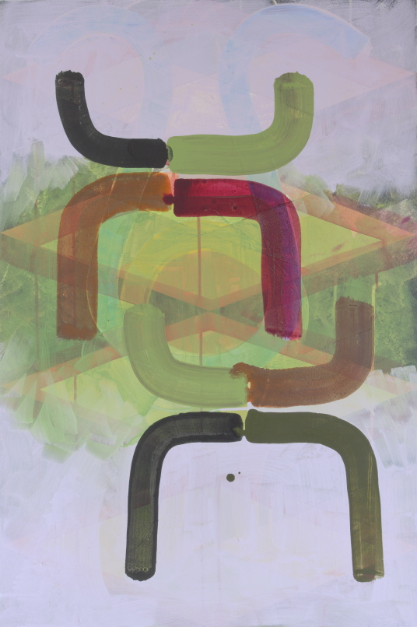
Can we construct a shared language of practice painting?
Abstract(ion)
Doubt
Pattern and Repetition
Colour
Gary Simmonds and Diana Taylor - A shared language of Painting?
Notes:
I am the course leader on BA Hons (Undergraduate) Fine Art Course at Sheffield Hallam University. Diana, a London based artist and PhD student and at Sheffield Hallam University, and I share some elements of common language in our art-work. We have been invited to talk about our work as a dialogue and we thought we would present some aspects of our practice where are work has some common points of interests, engagement and language.

Slide 2
Abstract(ion)

Slide 3
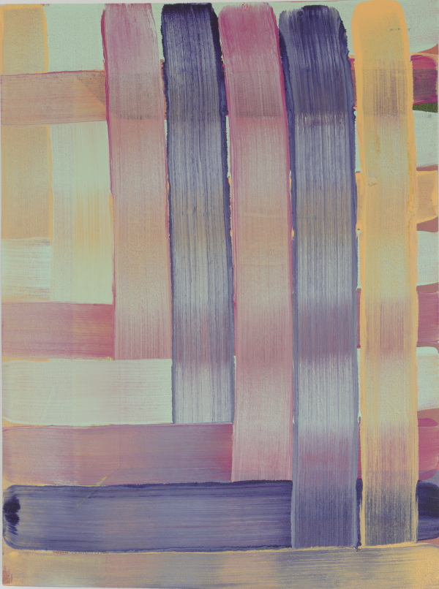

Slide 4
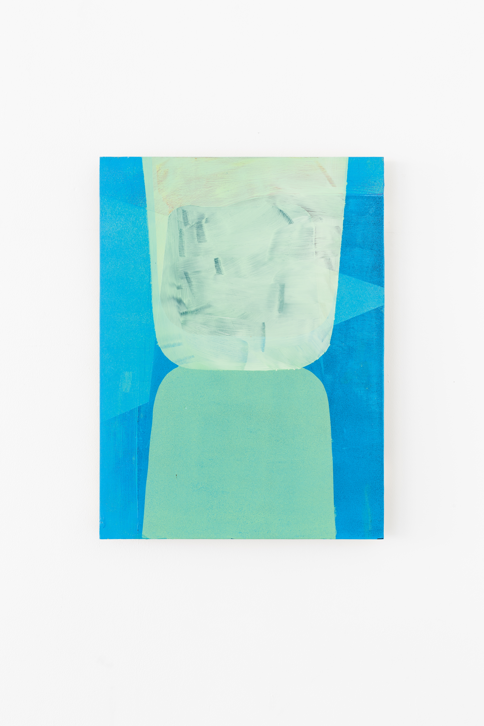

Slide 5
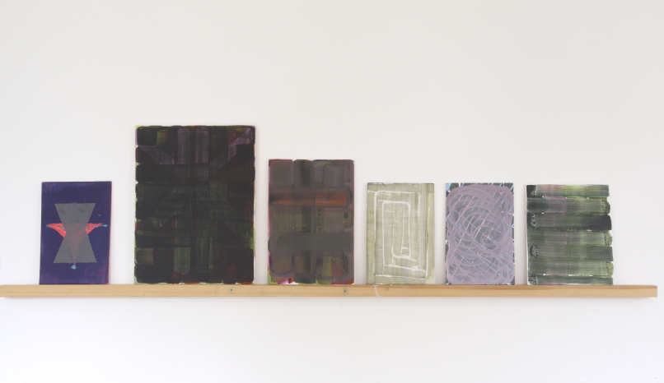

Slide 6
Doubt

Slide 7
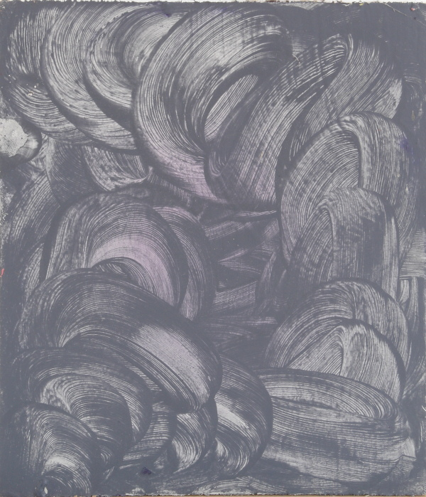
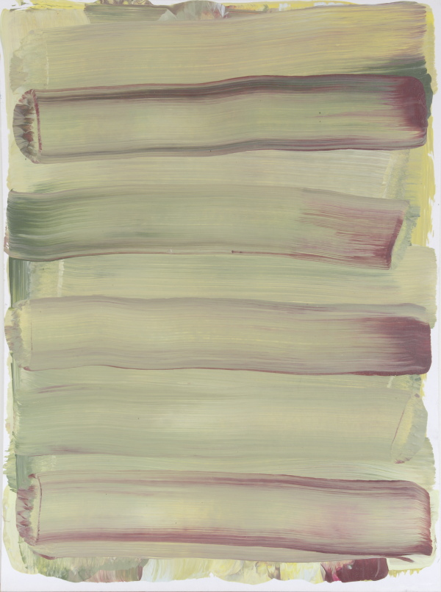
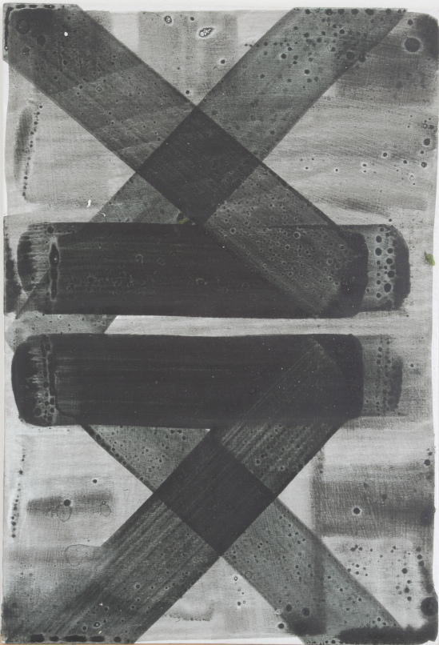
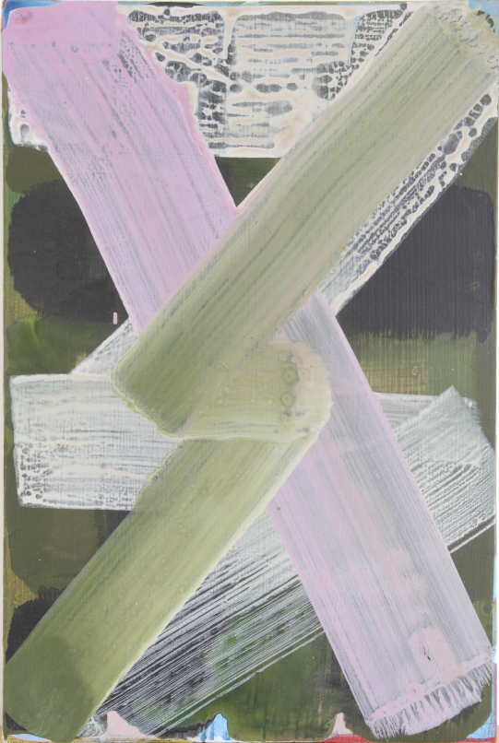
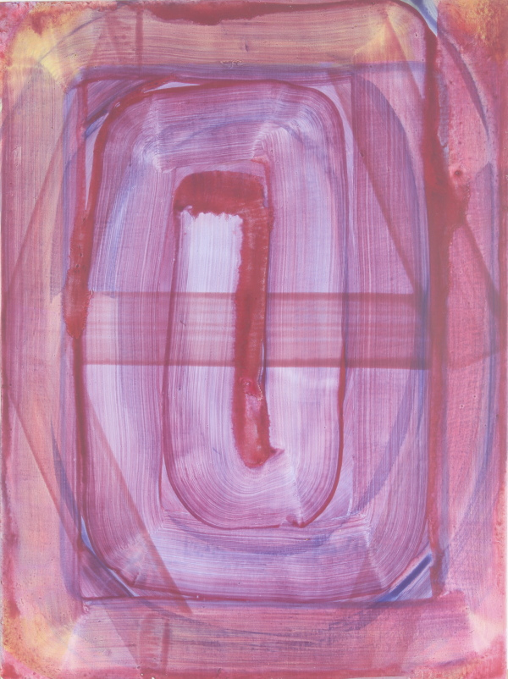
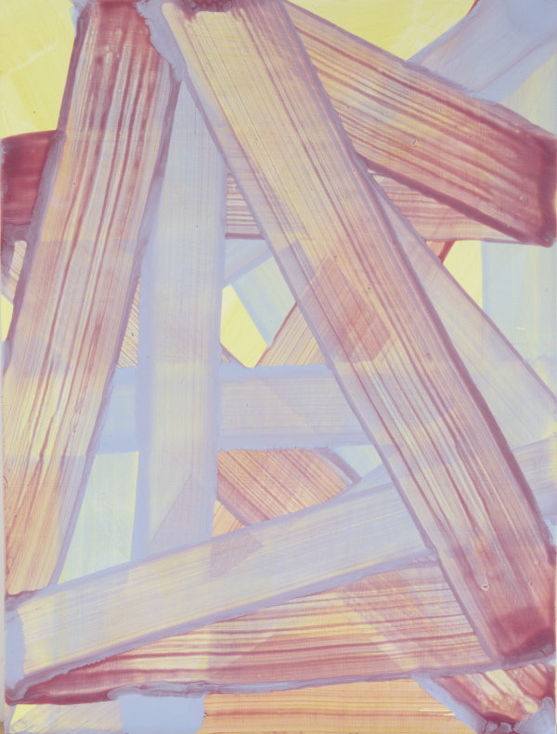

Slide 8
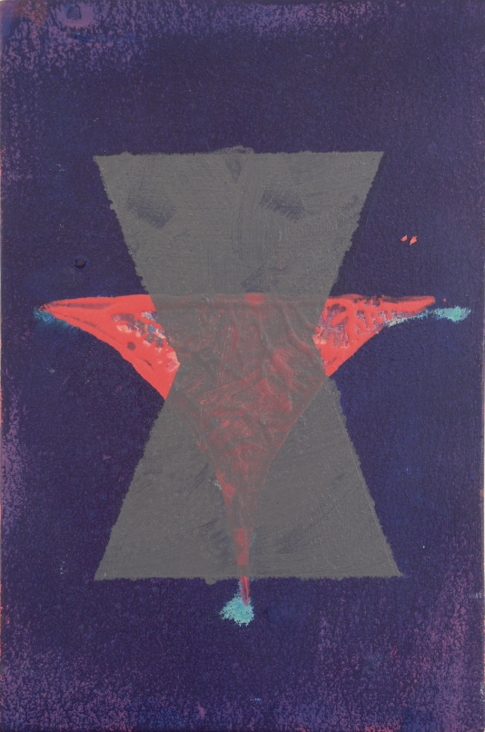

Slide 9
Printmaking to Pattern and Repetition

Slide 10
Cycles
Notes:
After making the site specific drill piece. I made a series of six large paper paintings, that acted almost as an exorcism of my time as a print maker. They were much like the structure of the earlier grid drill piece where using an cotton bud I printed the three primary colours on top of each other, in an ordered grid- 1cm apart from each other- across 1.5m x1.5m piece of paper, with permutation of three primaries being ryb, yrb, bry, etc. etc. taking the lead from Sol Le Witt and his systematic processes of production. They took be a couple of back aching months to make, they had to be made on flat surface in a studio only 7ft wide. The result was a conceptually tight and rigorous set of images, that played with mathematics, repettion and difference, colour theory, ideas of mass production and the error of the human, but the final result was really rather, dull- and grey.

Slide 11
Flock
Notes:
The grid- non-hierachy of- decision making- modernist trope- how to work composition within this. Leading on to co-ordinating seperates.

Slide 12
Flock detail

Slide 13
Quadrahex

Slide 14
Colour

Slide 15
Canopy

Slide 16
Mother in Laws Tongue
Notes:
In his slide talk Gary will introduce a wide range of contemporary abstract painters that supports the idea that abstract painting continues to have currency as a contemporary art practice. Using his practice as a starting point, Gary will explore a range of different themes that are current in abstract painting. He will look at artists who are engaged with a variety of different modes of working, from working with process as an act of contingency, who use ideas of trace as an act of engagement with the material of paint, artists whose work touches engage with much derided notions of ornamental and the decorative, artists
Declarative surface: Richard Shiff.
Headings:
Contingency:
Pollock, Louis, Davenport, Frize, Linda Benglis, Mike Stubbs, Alexis Harding, Callum Innes,
Trace:
David Reed, Lee Lozano? Wave paintings, Jason Martin, Zebedee Jones, DJ Simpson, Jane Harris, Monique Prieto, Jonathan Lasker,
Optical:
Bridget Riley, Victor Vasserely, Peter Davies, Jeremy Moon,
Ornamental:
Jane Harris, Beatriz Milhazes, Philip Taffe, Leslie Wayne, Fabian Maccacio,
Ornament and the Decorative:
Surface- moving around the image- Reed,
Beauty
Landscape

Slide 17
